Slide 1



ADRC COVID Grantee Webinar on Rapid Assessments and Reporting

Slide 2
Agenda
Welcome from ACL
Rapid Assessments Overview
ADRC/COVID Grant Semi-Annual Reporting Tool Overview + Walkthrough
Submitted Questions on Reporting Tool
Live Q&A
Next Steps

Slide 3
Welcome from ACL
4

Slide 4
Rapid Assessments Overview
5
Notes:
Overall, your responses in the rapid assessments were extremely helpful for us to better understand the great work you all are doing on the ground, as well as challenges you are facing so we can try our best to help you with those. Your responses to the reflection questions helped us choose topics for and prepare for the first to PAL calls on Social Isolation and Workforce and Volunteer Strategies we had last month. We hope these assessments were helpful for you all as well, to reflect about your work so far and thoughtfully strategize on best steps forward. Overall your responses indicated active engagement in rapid assessment and COVID response activities – most responses throughout were “yes” and/or “in-progress,” and you often explained when an item was not applicable to your state.
Today, we’ll briefly share some high-level themes from the rapid assessments. As I share some of the quantitative data from the rapid assessments, I’ll also sprinkle in some themes based on your responses in the reflection questions. We’ll continue sharing promising practices via Forumbee and during future PAL calls.
If there are areas in which you haven’t yet done work or are looking to expand, please don’t hesitate to reach out to us. We can put you in touch with other states who may have promising practices in particular areas to share, and we can share ideas and advice for particular problems you may currently be facing.

Slide 5
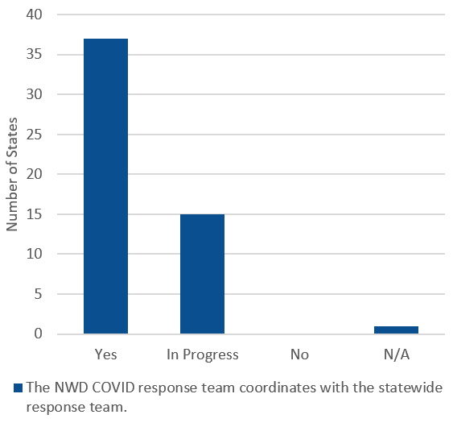
Statewide Coordination
Notes:
Most states reported having a rapid response team coordinating with the broader state efforts and existing emergency preparedness plans.

Slide 6
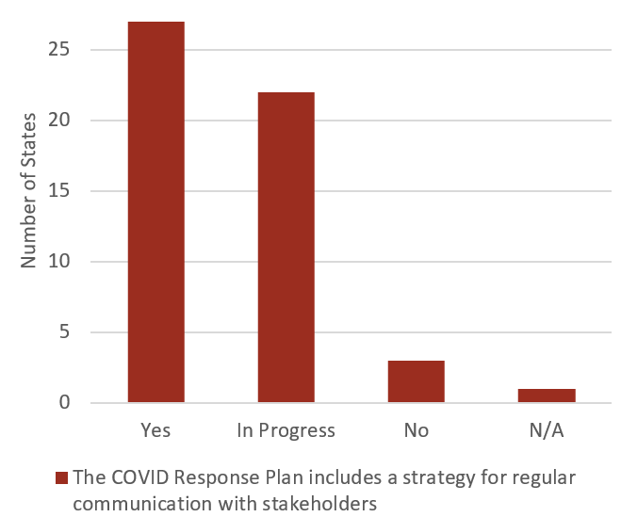
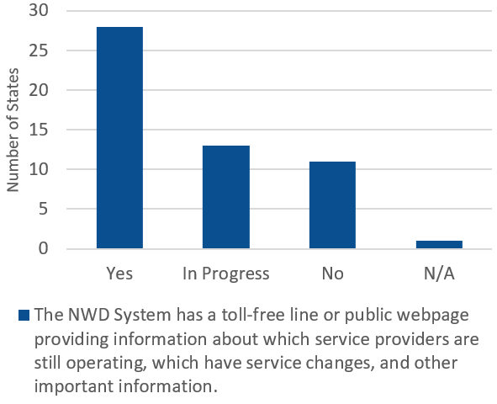
Communication and Outreach
Notes:
Almost all states also indicated having or being in the process of creating a strategy for regular communication with stakeholders such as people served by NWD, paid staff and volunteers, paid and unpaid family caregivers, and NWD System partners or potential partners, such as service providers.
For example, quite a few of you described quickly setting up centralized space on your websites or making available a toll-free line to share COVID-related updates and announce changes to services offered. Some of you also mentioned creating new ways of communicating with people, such as using newspaper advertisements, and adding individuals to your communication efforts, such as reaching out to all older volunteers in addition to regular clients for wellness check calls.

Slide 7
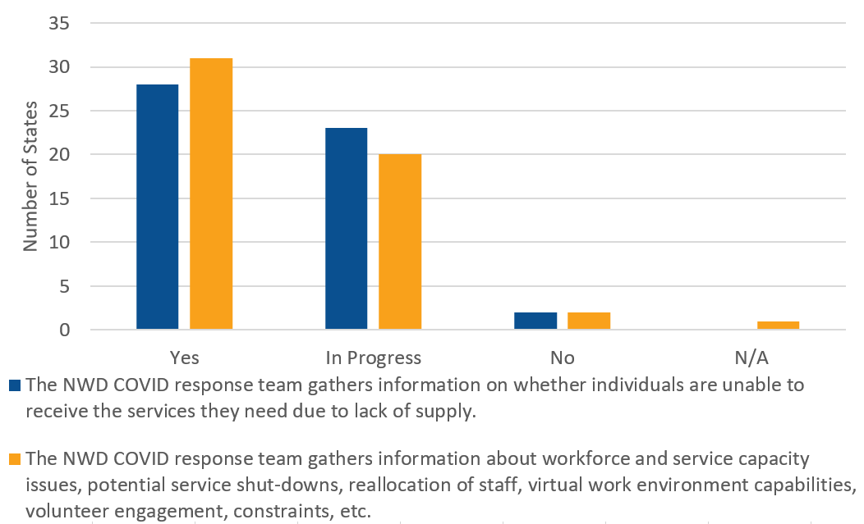
Information Gathering
Notes:
Overall, almost all of your COVID response teams had already or were actively gathering information about the state of affairs in order to best respond. The blue bars here show the number of states who reported gathering information on whether individuals were unable to receive the services they need due to lack of supply, and the yellow bars show the states gathering information about workforce and service capacity issues, volunteer engagement, service shutdowns, and other information related to capacity and workforce.
Only about a quarter of states, though, reported modifying the COVID response plan to outline a strategy for outreach to populations with the highest likely need or risk after assessing changes in population need.

Slide 8
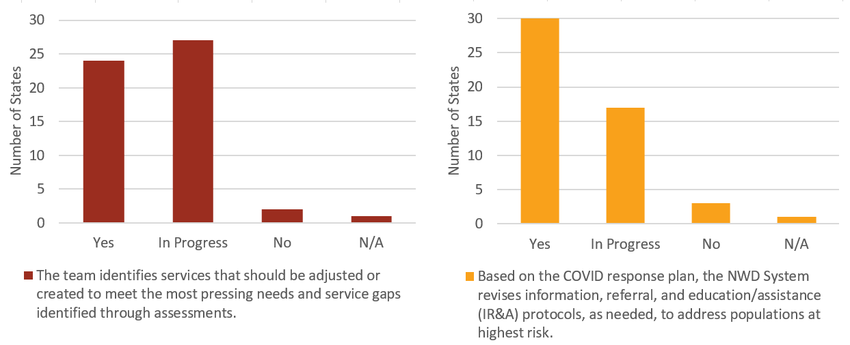

Adjusting Services
Notes:
In response to the information gathered, the majority of states identified services that should be adjusted due to COVID or new services to begin offering due to emerging needs. Based on the assessments, many states seemed to receive an influx of calls and needs at the beginning of the pandemic asking for assistance getting food or medicines, and as the pandemic has progressed, social isolation and caregiver support have emerged as other key focus areas.
States reported creatively forming new partnerships with grocery stores and local restaurants to both support local businesses and meet the rising need for home-delivered meals. States also described working on and using a variety of social isolation screening tools/scales and tactics, and finding ways to connect people by deploying and training people in using assistive technology, hosting virtual social events, and conducting home visits in people’s driveways.
Most of you also described adjusting your information, referral, and assistance protocols to respond rapidly to immediate needs and anticipate new needs. For example, states mentioned adding COVID screening questions to assess impact of COVID and make sure basic needs were met, proactively conducting wellness checks for individuals who had previously received NWD services, or streamlining intake questions to enable staff to respond to higher call volume.
We’ve shared some of the innovative examples you all have highlighted on Forumbee and during the PAL calls, and we encourage you all to continue sharing the creative ways you’re meeting the needs of your communities so we can all learn from each other!

Slide 9
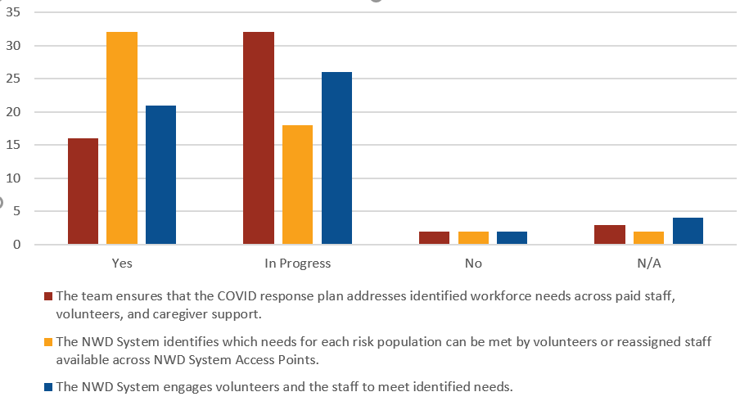
Adjusting Workforce
Notes:
Most states reported implementing or working towards adjustments in workforce and volunteer management to make sure all needs were met. For example, some states described working with other agencies to reassign library staff and Parks & Rec staff and others whose workloads have decreased due to COVID to help provide wellness check calls or deliver meals. When your older adult volunteers were no longer able to volunteer, some of your states started reaching out to those volunteers to combat social isolation and did outreach to welcome volunteers who were high school, college, and medical students or recently unemployed adults. States also reported team huddles to share information and strategize, trainings to help with burnout and working remotely, and mental health check-ins to support staff.
In addition, over half of you reported expanding or implementing programs to inform people about and encourage self-direction and/or provide reimbursement for family caregivers during COVID-19. Some states have found this to be a great solution for both facing workforce shortages and helping families find a caregiving situation that is comfortable for them given COVID precautions.

Slide 10
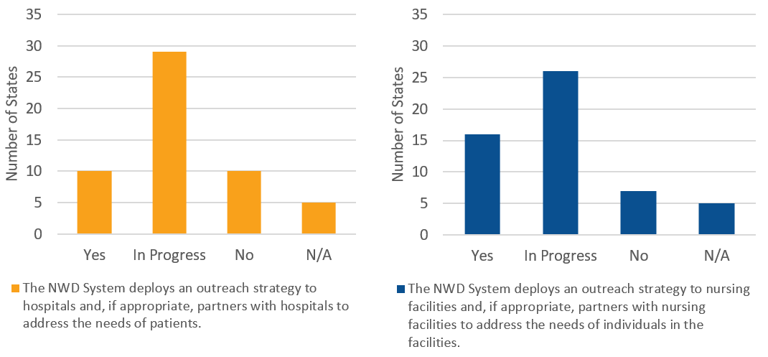
Hospital and Nursing Facility Partnerships
Notes:
Care Transitions was one of the areas where the fewest states responded “Yes” in the rapid assessment. The yellow graph on the left shows states’ responses to the question about outreach and partnerships with hospitals to address patient needs, and the blue graph on the right shows states’ responses to the question about nursing facility outreach and partnerships. Some states reported that calls and referrals requesting assistance transitioning home from hospitals and nursing facilities increased after the pandemic started, especially given dramatically high COVID case and death rates in some nursing facilities compared to the general population, and some of you reported strengthening existing partnerships with hospitals and nursing facilities and even developing some new partnerships since the pandemic began. Other states, however, described either a decrease in referrals or challenges building partnerships or gaining access to patients and nursing facility residents because facilities were closed to visitors and calls were difficult to coordinate. Based on your responses in the assessments, it sounds like this is an area a lot of you could benefit from discussion with each other to hear strategies and best practices. In addition to the Peer Hour focused on hospital care transitions we hosted on Tuesday, we are having another Peer Hour this coming Tuesday focused on institutional transitions. We’ll look forward to having you all join that call!

Slide 11
Looking Ahead
“This pandemic has brought with it some new challenges, but some of the solutions will be long-lasting and cost-effective.”
Notes:
As we read through your rapid assessment responses, it was encouraging to hear how a lot of you found that COVID served as an impetus for a lot of really great change. Several of you mentioned that COVID really brought to light a lot of areas where your processes were outdated, inefficient, or not streamlined, or where there were needs you weren’t aware of, and you’ve been able to make strong changes that will sustain long after the pandemic ends. And if you feel like you are currently in a phase facing a lot of challenges and are having trouble finding long-lasting solutions, please don’t hesitate to reach out to us! Our TA team is more than happy to share resources and work with you to help overcome some of the challenges you’re facing. We also feel that coming back to a version of this rapid assessment in a few months time may be helpful for states in understanding the progress made or changes in the environment, so we may revisit this work as appropriate. Before moving on to the grant reporting section of this meeting, I’ll close with a quote from one of the rapid assessments, which I found was encouraging as we continue this work into the future: “This pandemic has brought with it some new challenges, but some of the solutions will be long-lasting and cost-effective.”

Slide 12
ADRC/COVID Grant Semi-Annual Reporting Tool
12
Notes:
will walkthrough using screenshots of the tool

Slide 13
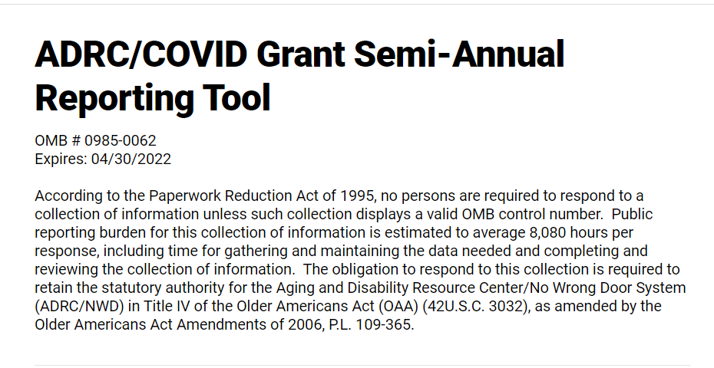
Overview
The ADRC/COVID Grant Semi-Annual Reporting Tool is a data collection tool serving as the semi-annual reporting requirement for states and territories receiving ADRC COVID-19 grant funds
First round of reporting will cover activities from April 1 – September 30, 2020
Instructions manual, glossary and survey link have been shared

Slide 14
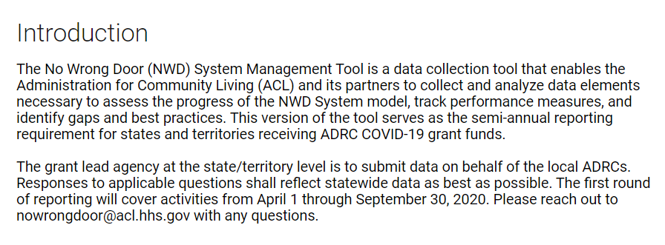
Introduction
Provides background information on the NWD System Management Tool and type of data collection for the ADRC/COVID Reporting Tool
Notes:
NWD MT background:
Type of data collection:
Responses shall represent all services and support provided by the state/territory’s Aging and Disability Resource Centers (ADRCs) or NWD System. This means the data reported in this Tool is not limited to grant-specific activities or budgets and instead shall represent statewide activity as best as possible.

Slide 15
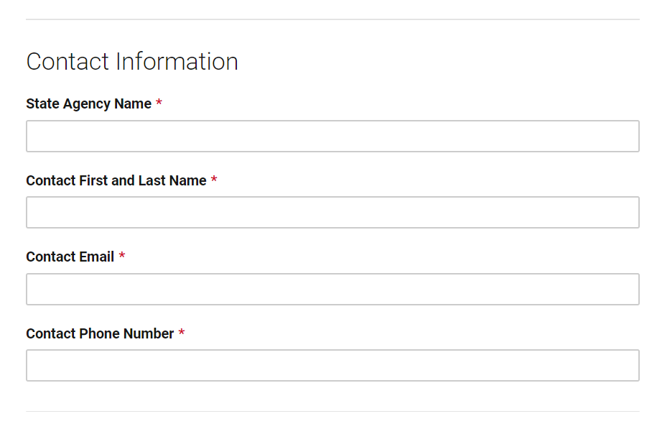
Contact Information
Will be filled out by the representative from the grant lead agency

Slide 16
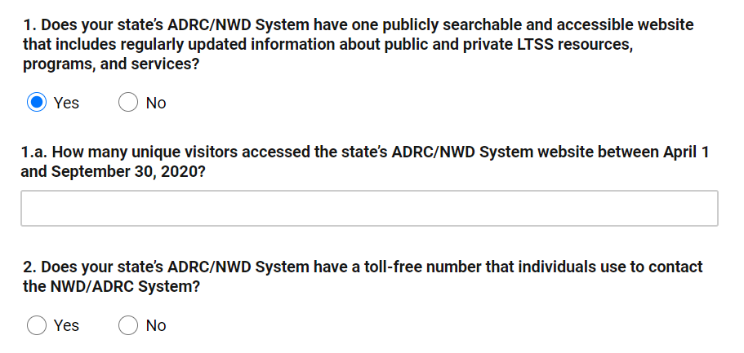
Data Collection Questions - Outreach
Question #1 – select “Yes” or “No”
  If “Yes” is selected, Question #1.a. will appear
Question #2 – select “Yes” or “No”

Slide 17
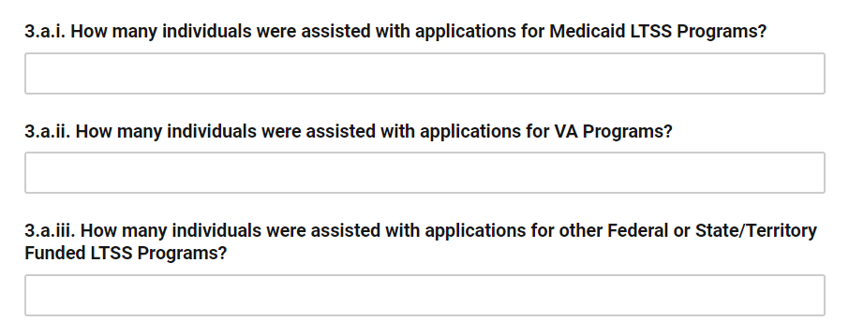
Data Collection Questions – Application Assistance
Question #3.a. – fill out the applicable fields for individuals assisted with applications
Question #3.b. – fill out the applicable fields for individuals assisted with financial assessments
Question #3.c. – fill out the applicable fields for individuals assisted with functional assessments
Notes:
Assistance with applications includes the process of helping to complete the application, such as answering questions, scheduling, screening, and any other appropriate steps to ensure completion of the application.
Our general definitions for Medicaid LTSS vs Federal or State funded programs are provided in the glossary appendix of the manual

Slide 18
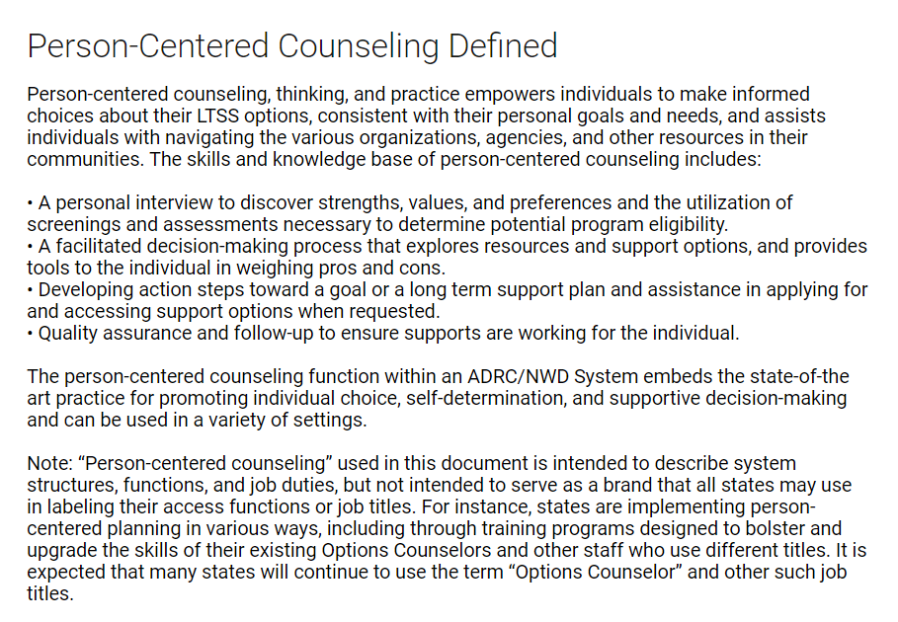
Person-Centered Counseling Defined
Provides an overview of person-centered counseling and how it will be defined in the context of the Reporting Tool

Slide 19
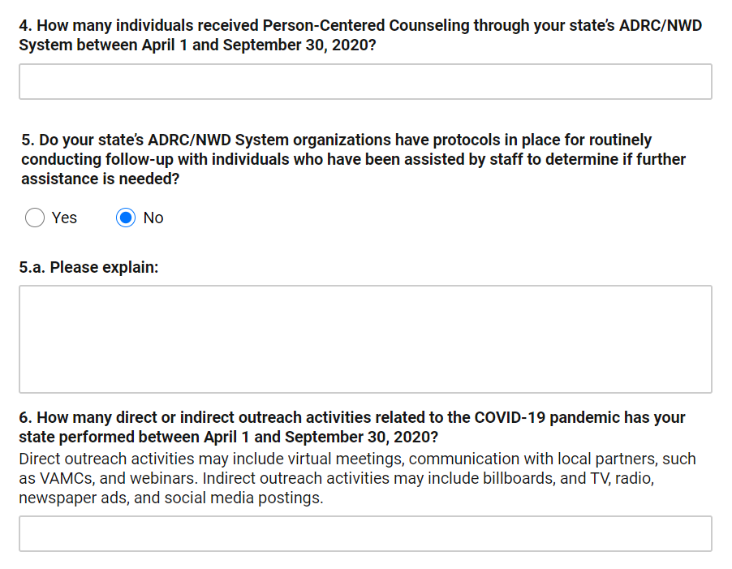
Person-Centered Counseling Questions
Question #4 – fill out the field for individuals who received PCC
Question #5 – select “Yes” or “No”
  Question #5.a. will appear if “No” is selected
Question #6 – fill out the field for direct/indirect outreach activities related to COVID-19

Slide 20
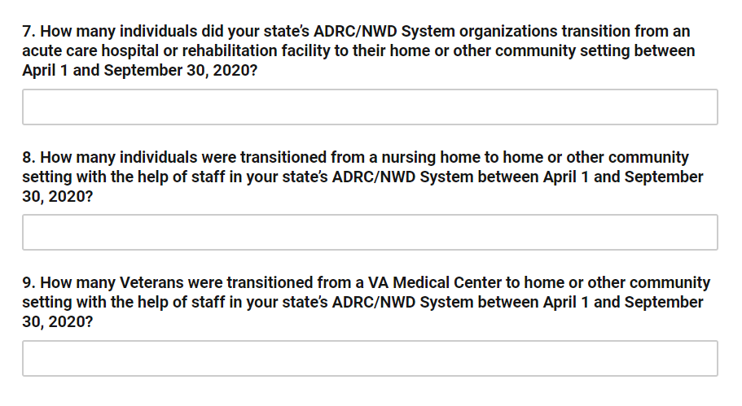
Data Collection Questions - Transitions
Question 7 – fill out the field for individuals transitioned from an acute care hospital or rehabilitation facility
Question 8 – fill out the field for individuals transitioned from a nursing home
Question 9 – fill out the field for Veterans transitioned from a VA Medical Center

Slide 21
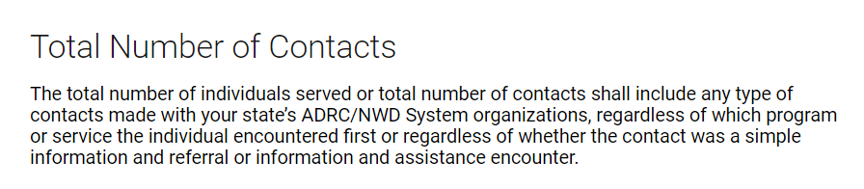
Total Number of Contacts - Defined
Provides a definition for “total number of contacts” in the context of the Reporting Tool
Notes:
For the last two questions in the tool – questions 10 & 11, we are capturing total number of contacts, or what might be called units of service.

Slide 22
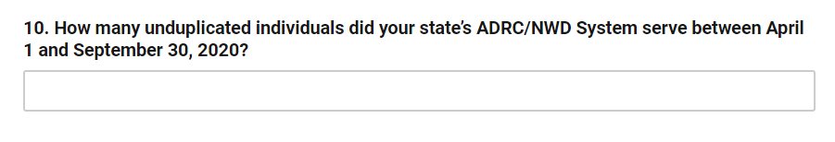
Total Number of Contacts - Unduplicated
Question #10 – fill out the field for number of unduplicated individuals served

Slide 23
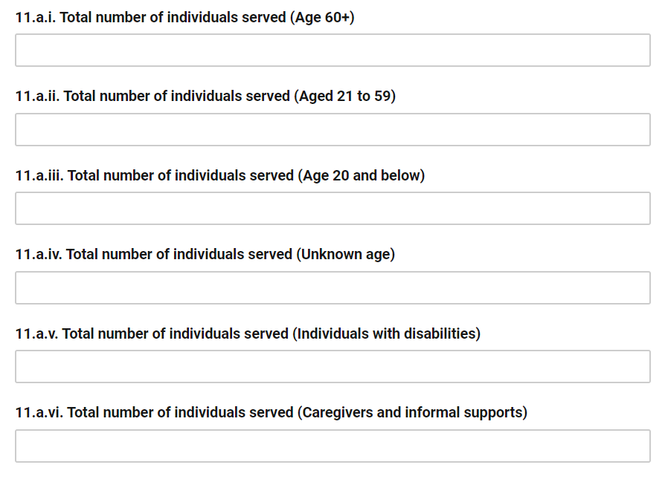
Total Number of Contacts – Demographics & PCC
Question #11.a. – fill out the applicable fields for total number of individuals served
Question #11.b. – fill out the applicable fields for total number of individuals that received PCC
*Individuals that meet multiple demographic categories should be counted in all applicable categories

Slide 24
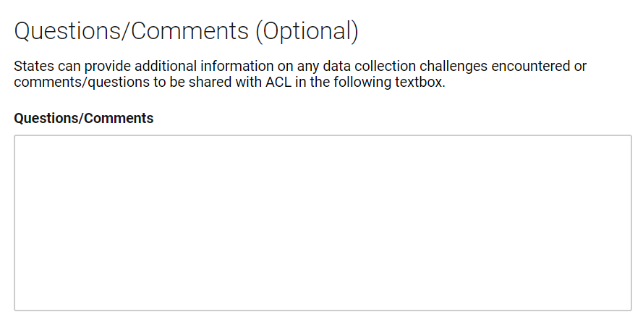
Questions/Comments (Optional)
States may opt to provide additional information on any data collection challenges or general questions/comments to share with ACL

Slide 25
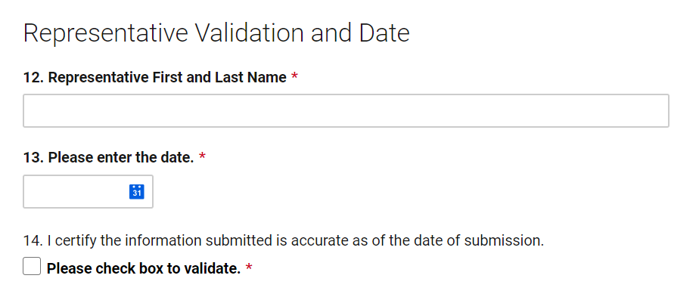
Representative Validation and Date
Will be completed by the representative from the grant lead agency to validate the state’s submission

Slide 26
Submitted Questions
26

Slide 27
Submitted Question #1
Q: For the question “How many people did your organization support to complete functional assessment(s) for the following programs?,” does ACL want a count of newly assessed or those who are re-assessed and remain open to a waiver or other state funded program?
A: Please report the total number of assessments, including newly assessed and re-assessments.

Slide 28
Submitted Question #2
Q: Does ACL want to know how many people entered into a waiver or state funded service, or just how many people were assessed or re-assessed?
A: Only count the number of assessments completed. We do not need to know how many individuals actually enrolled in a program.

Slide 29
Submitted Question #3
Q: Does ACL want to know ethnicity or just the demographics listed in the Reporting Tool?
A: At this time, we are only collecting the demographics listed in the Tool.

Slide 30
Submitted Question #4
Q: Are we expected to report data based only on services that were provided using ADRC/COVID funds?
A: No. Data submitted shall represent all services and supports provided by ADRCs across the state/territory. Data reported in this Tool is not limited to grant-specific activities or budgets and instead shall represent statewide activity as best as possible.

Slide 31
Submitted Question #5
Q: Will ACL require narrative to accompany the Reporting Tool so additional information is provided on the data entered? For example, if some fields where reported “0” because the data we have available does not get to the granularity of some of the questions, should we explain this?
    A: An optional textbox is included at the end of the survey where states can note any data collection challenges or share any general notes with ACL.
Notes:
We encourage this, especially anything around the example given in this question.

Slide 32
Live Q&A
32

Slide 33
Next Steps
33

Slide 34
Next Steps
First semi-annual reporting tool submission is due October 30, 2020
Reporting tool link and manual will be shared again as a reminder at the end of this month
Upcoming activities:
    September 15, 3-4 PM: Hospital2Home – Dementia Capable Care Transitions: Better Care, Better Outcomes
    September 30: NWDBC Semi-Annual Reports due
  Don’t forget – the ACL Technical Assistance Community site is your resource to stay informed, access resources, and connect with your peers!

Slide 35

Questions?
Additional questions can be submitted to ACL at:
NoWrongDoor@acl.hhs.gov

