Slide 1
COVID-19 Vaccine Toolkit for Faith-based Organizations
Material on COVID-19 Awareness for faith-based leaders and organizations

Slide 2
Purpose and Goal
All of us at the Department of Health and Human Services and the Agency on Aging are contacting you today to aid us in the fight against COVID-19. Currently, we are encountering obstacles in vaccination efforts in rural areas in Montana.
The goal is to explain how faith-based leaders like you can use this toolkit to build vaccine confidence among your staff, congregation, and other people in your community.
Vaccine confidence is the trust that patients, their families, and providers have in:​
Recommended vaccines
​Providers who administer vaccines
Processes and policies that lead to vaccine development, licensure or authorization, manufacturing, and recommendations for use

Slide 3
Your Role as a Faith-Based Leader
As leaders within your community, many people trust that they can look to you for advice or guidance. You have the unique ability to address potential concerns, fears, and anxieties regarding COVID-19 and the vaccines with compassion and authority in a comfortable environment.
We want to provide you with the easily accessible and accurate information about COVID-19 and COVID-19 vaccines to allow you to provide guidance with confidence.
This toolkit has basic information about the vaccine, common rumors with reasons they are incorrect, addressing vaccine hesitancy, examples of possible messages, and credible resources with contacts to provide any assistance you or anyone else may need.

Slide 4

Facts About COVID-19 Vaccines
Three authorized vaccines in the US: Johnson & Johnson, Moderna, and Pfizer
Johnson & Johnson
Vector Vaccine
65% effective
Only one dose
Ages 18+
Pfizer
mRNA Vaccine
95% effective
2 Doses 21 days apart
Ages 12+
How do we know they’re safe?
Moderna
mRNA Vaccine
94% effective
2 Doses 28 days apart
Ages 18+

Slide 5
What is Vaccine Hesitancy?
Vaccine Hesitancy is when someone may be reluctant to get a vaccine because of distrust or misinformation. They may have concerns due to mistrust because of the history of abuse in the medical system due to racism and other forms of discrimination or personal experiences in the health care system. They could also be concerned about safety because of the speed of the trials, their age or disability, disinformation, or mistrust of the government.
Tips for speaking with those hesitant
Acknowledge that your friend or family member wants the best for themselves and their loved ones.
Ask if there’s anything about the COVID-19 vaccine that they’re unsure about.
Offer information from trusted resources that addresses their concern.
Share stories that frame why you chose to get the COVID-19 vaccine.
Encourage them to talk with their provider or local clinic.
Notes:
Addressing Vaccine Hesitancy (wa.gov)

Slide 6
Debunking Common Rumors
Is it safe for me to get a COVID-19 vaccine if I would like to have a baby one day?
  Yes. If you are trying to become pregnant now or want to become pregnant, you may safely get a COVID-19 vaccine when available. There is currently no evidence that COVID-19 vaccines cause any problems related to pregnancy or the development of the placenta.
  In addition, there is no evidence that male or female fertility issues are a side effect of any vaccines, including the COVID-19 vaccine.
Can the COVID-19 vaccine make me sick with COVID-19?
  No. None of the authorized COVID-19 vaccines contain the live virus that causes COVID-19. The symptoms you may feel after receiving the vaccine is your immune response
More myths and explanations here
Notes:
Myths and Facts about COVID-19 Vaccines | CDC

Slide 7
Tools and Resources
In the rest of this toolkit, we provide several resources at your disposal. You do not have to use any of the materials provided; however, we ask that you do maintain ways to keep your congregation safe.
Chase Smith – COVID-19 Vaccine Access Grant Coordinator
Local County Health Department information
Frequently Asked Questions
Paper Material and Resources
Talking Points on Vaccines and Hesitancy
Social Media Messaging

Slide 8
COVID-19 Vaccine Access Grant Coordinator
Chase Smith develops public outreach methods for Area III (Teton, Pondera, Glacier, Toole, Chouteau, Liberty, and Blaine counties) and uses grand money to support vaccination efforts.
Readily available for speaking, reference information, group consultation; a resource for you.
Supports vaccine access through Grant,
  Can help support transportation to/from vaccination appointments financially.
Contact information
  Based out of the Agency on Aging in Conrad
    Phone: (406)271-7553
    Email: csmith@aoamt.gov

Slide 9
Local County Health Department
They can provide additional information or guidance on COVID-19 vaccines as well as having vaccines readily available to be administered.
Your local county health department is a resource for all health needs not just a site to get the COVID-19 vaccine.
County | Phone
Blaine | (406)357-2345
Chouteau | (406)622-3771
Glacier | (406)873-2924
Liberty | (406)759-5517
Pondera | (406)271-3247
Teton | (406)466-2562
Toole | (406)424-5169

Slide 10
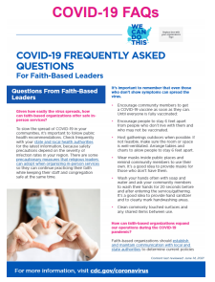
Frequently Asked Questions
Your congregation will have many questions about how they can keep practicing their faith during the COVID-19 pandemic. COVID-19 Frequently Asked Questions for Faith-Based Leaders is a resource for you and your staff to have on hand with answers to common questions your community members might have.
Suggested Use
Hang in shared areas such as doorways, lounges, restrooms, and other visible high traffic areas.
Share in bulletin boards or email/online newsletters.
Click here to download

Slide 11
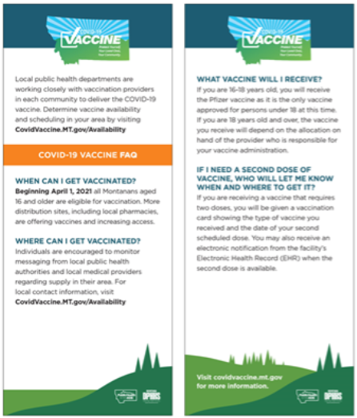

Paper Materials and Resources
Public Health in the 406 and the State Department of Health and Human Service has provided a service to order free resources to post around your organization.
Click Here to Order Free Printed Materials

Slide 12
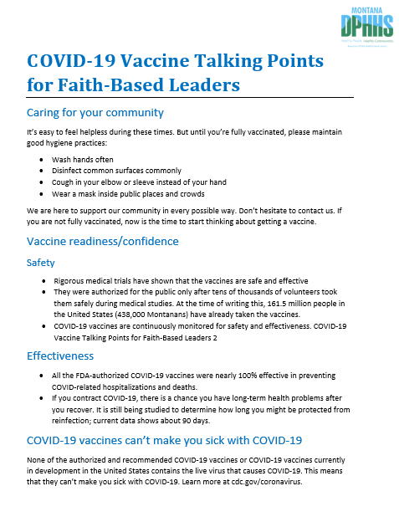
Talking Points
Provided here are talking points you can use in conversations with fellow members. It covers procedures if unvaccinated, vaccine information, and vaccine hesitancy.
Click Icon to Download
Suggested Use:
Use as a reference when talking to fellow members.
Share with other members within your community.

Slide 13

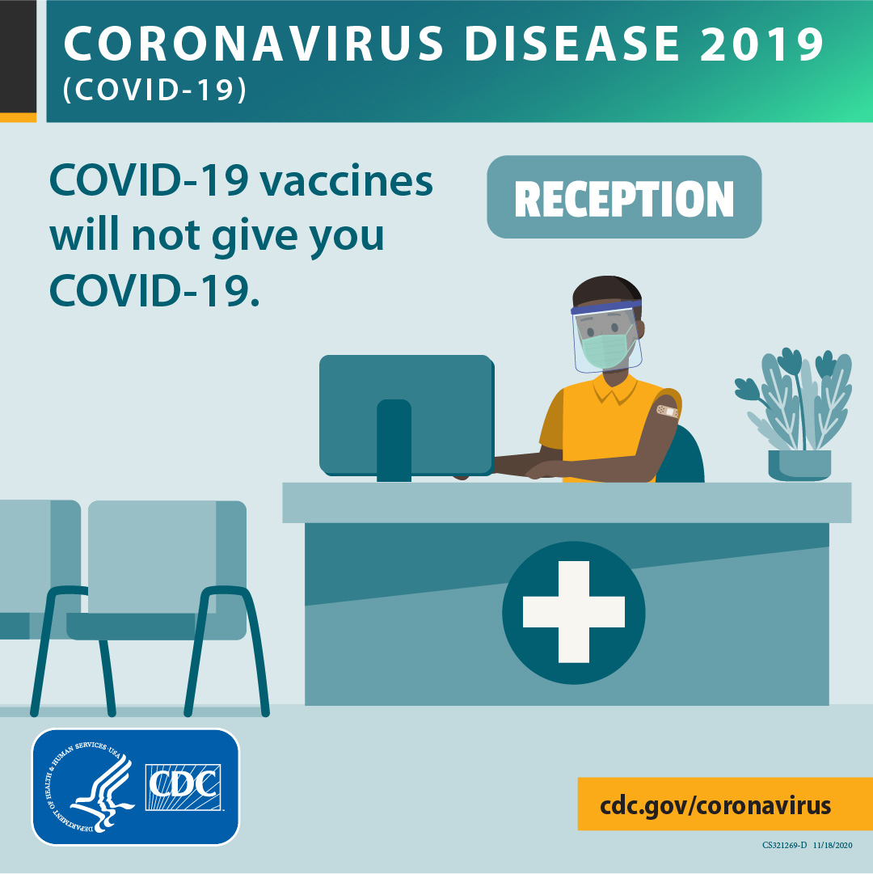
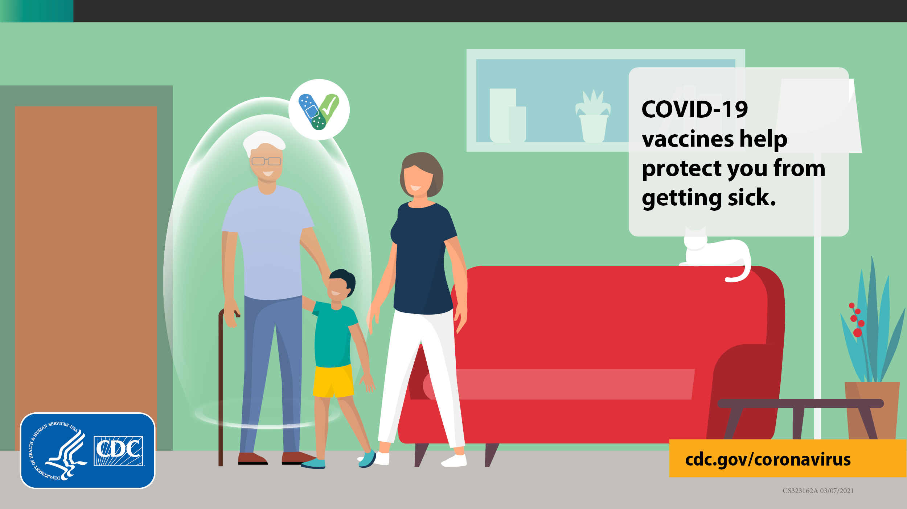
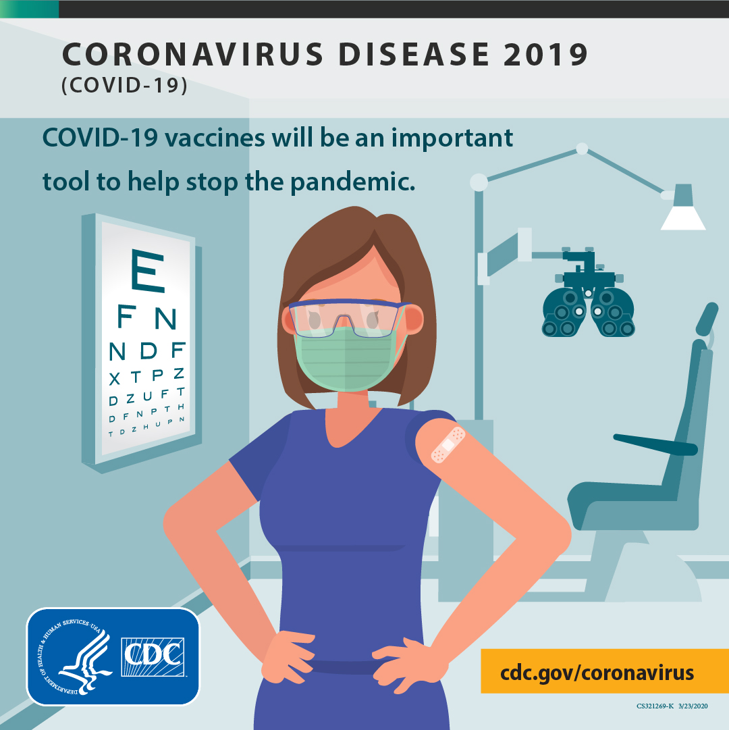
Social Media Messaging
Social Media is another way Faith-Based Leaders interact with their congregation. In the link provided you’ll find sample posts on vaccines you can use on Facebook, Instagram, and Twitter.
Click Here To Visit and Download

Slide 14
For More Information
Resources for more information
https://www.cdc.gov/coronavirus
Covid19 Home (mt.gov)
MONTANA RESPONSE: COVID-19 - Coronavirus - Global, National, and State Information Resources (arcgis.com)
COVID-19 Vaccination Communication Toolkit for Health Systems and Clinics | CDC
A Communicator's Guide to COVID-19 Vaccination | Institute for Public Relations (instituteforpr.org)
World Heath Organization: Advice for the Public
County or Tribal Health Department Contacts

Slide 15
Thank You for Helping Keep Out Communities Safe and Healthy!
With Genuine Thanks, State of Montana Department of Health

