Slide 1






Opening Every Door: Using Partnerships and Technology to Boost Access in No Wrong Door Systems
August 25, 2026
Notes:
Christina
Outcomes - Effective marketing and use of technology increases public awareness and streamlined access to aging and disability services. This workshop will explore how marketing and use of technology, including AI, has advanced state No Wrong Door systems: its role, effective methods, and state examples. It will include a panel of representatives from states that have raised the public’s awareness and made it easier to navigate and access aging and disability services. The workshop will be interactive, incorporating peer discussions that encourage participants to engage directly with panelists.
Intro self – Kristie to intro herself
Roles – Facilitator, part of NWD technical assistance resource center (intro Kasey and Emily as well in audience)
Working agreements – sit next to someone who to can talk with

Slide 2
Agenda
Warm-up
Discussion
No Wrong Door Vision
State Panel
Notes:
Christina
Pass out half sheet for participants to use

Slide 3
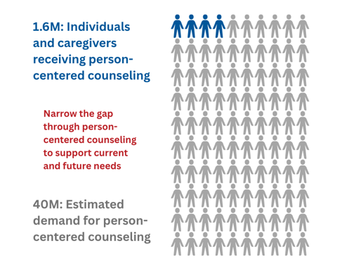
No Wrong Door Reach & Marketing
Person-centered counseling:
Assists with any immediate needs and plans for future needs
Identifies goals, strengths, and preferences, and who should be part of the process
Involves a comprehensive review of and linkage to private resources and informal supports
Facilitates informed choice of available options and the development of the person-centered plan
Helps individuals apply for public programs and navigate through the entire eligibility process
Follows-up to ensure services are initiated and meet the needs of the individual, and is adjusted as necessary
Notes:
Christina
The National Challenge: Open with the data point that 40 million people currently do not know where to go for support. We often hear I don’t know where to go for support – well to put some numbers to that, we collected available numbers and made some estimates - The number of people receiving PCC is estimated from No Wrong Door grantee reporting. The number of people conservatively estimated to need PCC each year is based on the number of people who are Medicare beneficiaries, Veterans, 17-year-old youths with a disability aging out of school supports, and family caregivers. A variable portion of these groups is estimated to need PCC each year.
Run through PCC bullets and mention they are from key elements
This establishes the urgent "Why" behind the session
Think: identify and write down their "tangled knot” - a challenge regarding IT procurement, data sharing, or marketing that feels hard to untangle because pulling on one thread affects the others.
Contextual Challenges: Participants are encouraged to surface common challenges such as IT/MIS procurement hurdles, legacy system integration, or the burden of coordinating data entry across multiple systems, limited funding, etc.
Explain handouts- give quiet time to reflect, then share with a partner
Pair: Share with a partner (maybe use padlet to surface learning across the room)

Slide 4
ACL’s Vision for Access Systems
Notes:
Christina

Slide 5
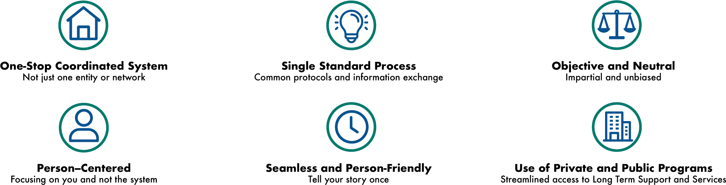
No Wrong Door
A No Wrong Door system makes it easier for people to get the services they need.
Notes:
Kristie
NWD is an initiative initially of both ACL and CMS and also VHA as you will see in a few slides
The most important concept we would like you to take home today is that No Wrong Door is not a grant program, but a strategic framework/vision for how states can operationalize the ACL priorities of “choice and participation as related to community living” and advance the Make America Healthy Again (MAHA) agenda
One stop coordinated system: Efficiency is at the heart of this framework by maximizing use of federal and state dollars via coordination and collaboration among the network that centers on improving the experience of the individual “ensuring that government programs are a safety net of last resort”. Notice it promotes the use of private and public programs.
It helps organizations have a single standard process and fosters collaboration and state innovation and this working together can help demonstrate the ROI of implementing the NWD vision and therefore contribute to sustainability.
It is objective and neutral and can offer person-centered support in a seamless way, so people only have to tell their story once no matter what door they enter.

Slide 6
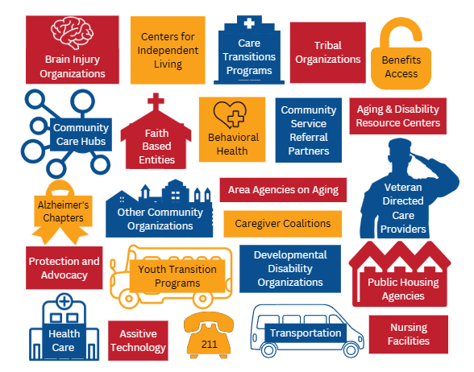
Federal Vision; State Governance
No Wrong Door is a network of state agencies and community-based organizations that help people access long-term services and supports (LTSS) by coordinating entry points.
Notes:
Kristie
- - In the current climate with the potential for shrinking budgets, partnership will become even more important. How well do these partners collaborate in your state? Each state is in a different place in terms of No Wrong Door sophistication
States are at various points in their collaboration across access point. Share Michigan example as best practice

Slide 7
State Panel

Slide 8
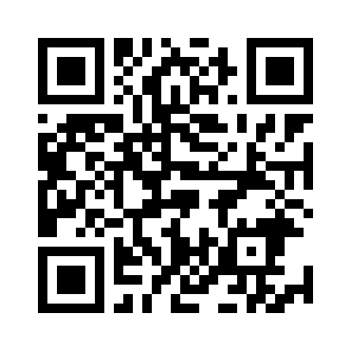
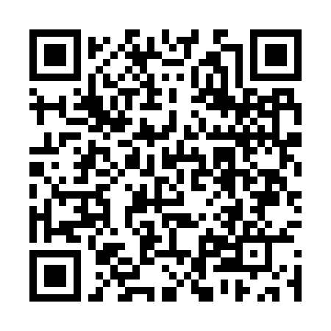
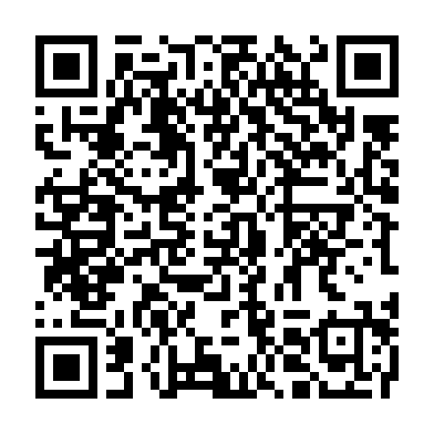
State Innovations
Utah
Virginia
Maryland

Slide 9
Discussion
How can this be applied to your own work?

Slide 10
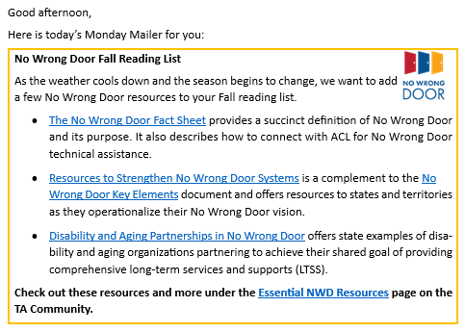
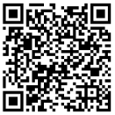
Stay in touch!
The Monday Mailer is a brief, weekly email with resources, events, and opportunities related to No Wrong Door
Notes:
Christina
Join MM mailing list
https://www.ta-community.com/t/h7yzr7z/add-me-to-the-monday-mailer-distribution-list

