Slide 1
Addressing Vaccine Hesitancy in Friends and Family
Chase Smith B.S.

Slide 2




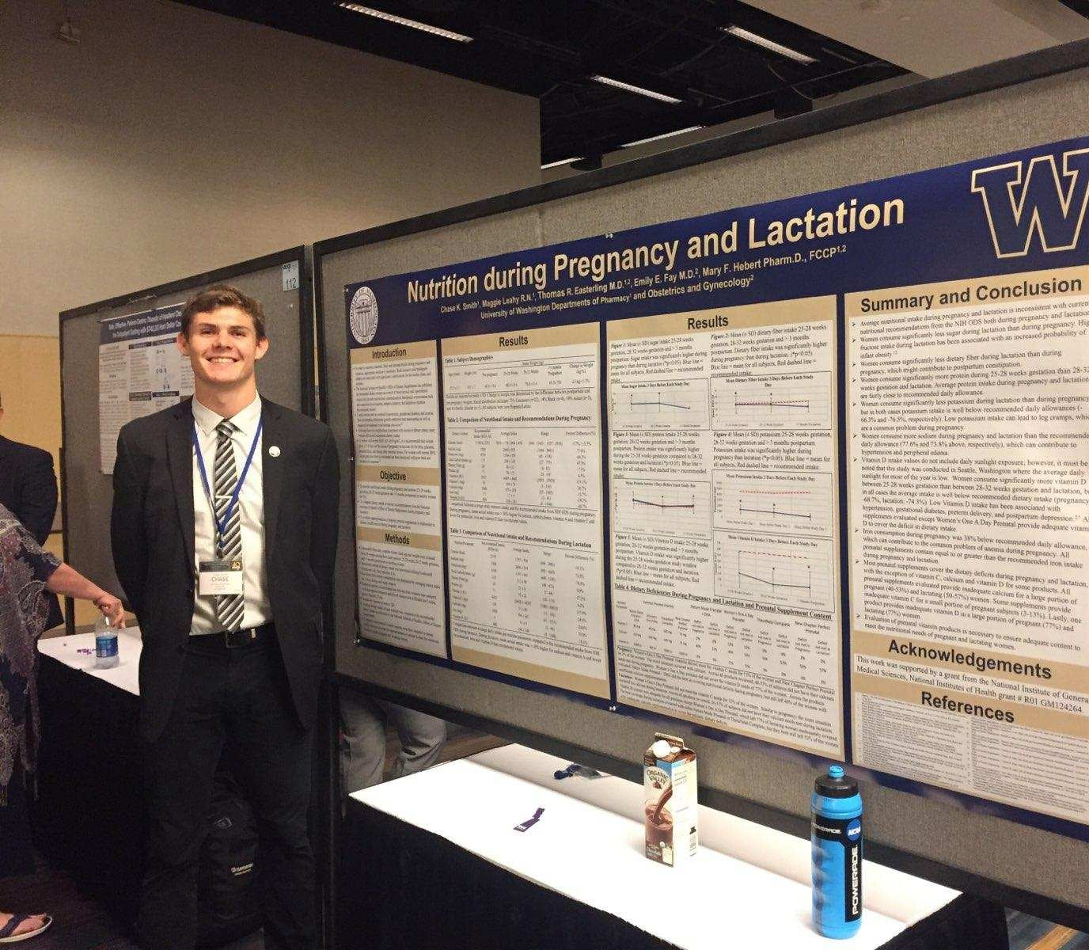
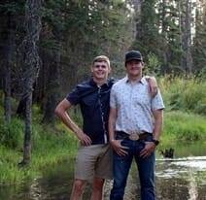
A Little About Me

Slide 3
What is Vaccine Hesitancy?
Confident Compliant Hesitant Defiant
One who gets vaccinated because it is recommended or required in parts of their lives, may be hesitant but is often reassured with education.
Reluctancy because of distrust or misinformation that is mal-placed by different forms of media. Possible to be educated to want a vaccine.
One who is a vaccine advocate, often goes out of their way to get vaccinated.
Absolute refusal toward vaccinations due to legitimate health concerns or religious beliefs.

Slide 4






RUMORS Associated With the COVID-19 Vaccine

Slide 5
What Can You Do?
Acknowledge that your friend or family member wants the best for themselves and their loved ones.
Ask if there’s anything about the COVID-19 vaccine that they’re unsure about.
Offer information from trusted resources (like the Centers for Disease Control and Prevention or Department of Health) that addresses their concern.
Share stories that frame why you chose to get the COVID-19 vaccine.
Encourage them to talk with their provider or clinic
Notes:
https://www.doh.wa.gov/Portals/1/Documents/1600/coronavirus/348-801-AddressingVaccineHesitancy.pdf

Slide 6
Keep in mind
Just become someone is confused or fearful about vaccines, doesn’t make them a bad person. People have the right and should individually assess and ask questions about all vaccines to make the best decision.

Slide 7
A way out
We have two available strategies to put the pandemic behind us. The first is we get the coronavirus and hope that we don’t have symptoms but know that it can affect any of our organ systems, cost lifelong damage or death, and have a limited immunity window. The second is we get the COVID-19 vaccine, which could cause a few days of fever, muscle aches, and chills.

