Slide 1



Caregiver Governance Grant
NWD System Initial Mapping Findings

Slide 2
Findings Related to Caregivers
No central resource for triaging needs for caregivers
Caregivers are not seeking information or supports until in a crisis, adding to the difficulties of navigating the system
Fear of or lack of trust in the system, often due to bureaucratic burden
Overreliance on family and consumer advocate networks/word of mouth to learn about and access services
Inconsistent screening and assessment processes and inadequate assessment tools
Notes:
Triaging Caregiver Needs
Caregivers must tell their stories multiple times to receive information and services
Little effort exists to integrate caregiver support programs into broader LTSS System
Caregivers reported difficulty in finding assistance that is needed and that their concerns are not handled in a timely manner and facilitation of caregiver applications are required at every level
Providers indicated that having an assessment specific to caregivers (e.g., TCARE) has proven successful for their process
Caregiver System Access
Caregivers often to not see themselves as someone who needs, is eligible for, or should access LTSS, and there is stigma around accessing these services in some cases
When caregivers do want to access services, they do not know what is available and do not know where to go for help
Difficulty navigating system and finding information because of limited time availability, due to responsibilities, work, essential daily tasks
Caregivers often delay identifying themselves as caregivers until they are already into the system, and often do not seek services until they are in a crisis; in both instances, these add a layer of complexity to their case and make finding services more difficult
Lack of Trust in System
Caregivers consider LTSS System difficult to navigate and challenging to find information from
Lack of support for caregivers in finding and choosing appropriate services
Lack of follow-up by agencies who were contacted for assistance by caregivers
Caregivers indicated staff were often not forthcoming and did not provide needed information, forcing caregivers to rely on informal networks for information and support
Family/Consumer Network Reliance
Caregivers indicated staff were often not forthcoming and did not provide needed information, forcing caregivers to rely on informal networks for information and support
Caregivers in some states rely heavily on word of mouth and advocacy networks to learn about and access needed services
Caregivers often rely on the internet or websites, friends and family members, and disability service organizations for information and to learn about services
Screening and Assessment Processes/Tools
Limited infrastructure in place to support caregivers – intake and screening protocols often do not ask about family caregivers
Caregivers face challenges specific to finding information and assistance when moving between different states with different benefits
Information provided to caregivers is often not consistent
Where standardized assessments and support planning processes are used, they collect limited information on caregivers and may not include them in support plans

Slide 3
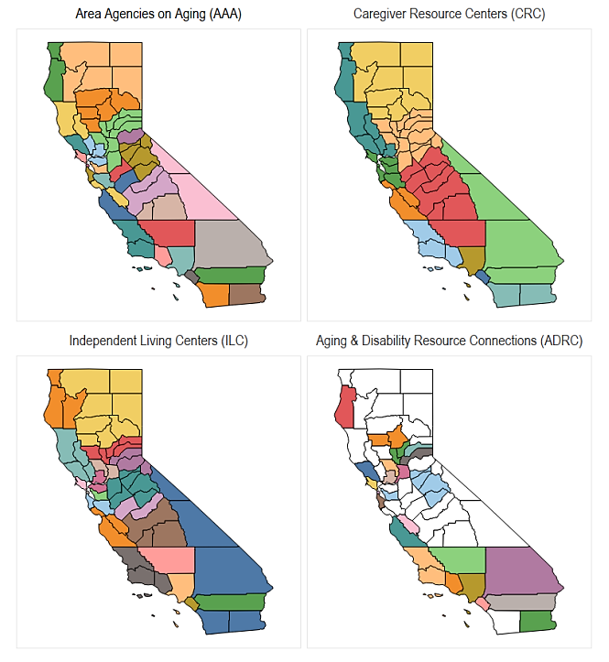
California
Geographic Coverage by Organization Type
System Gaps
* Lack of a centralized access point across all LTSS programs and services
Patchwork of programs is difficult to navigate
* Low awareness and understanding of existing programs
Little coordination between programs and department
Access options vary based on location
Workforce and capacity challenges
The current LTSS system is not equally accessible
* Inadequate technology and data infrastructure hinder the LTSS system’s performance
* Indicates gaps that grantees have listed as a priority to address
Submitted 1/31/24
Notes:
From California’s Mapping Deliverable:
California’s maps demonstrate the aging and disability network’s geographic coverage by organization type including AAAs, CRCs, ILCs, and ADRCs. During mapping, CA identified that paid and unpaid caregivers play a critical role in providing support to older adults and people with disabilities and the A&D NWD System should be designed with consumers and caregivers at the center.

Slide 4
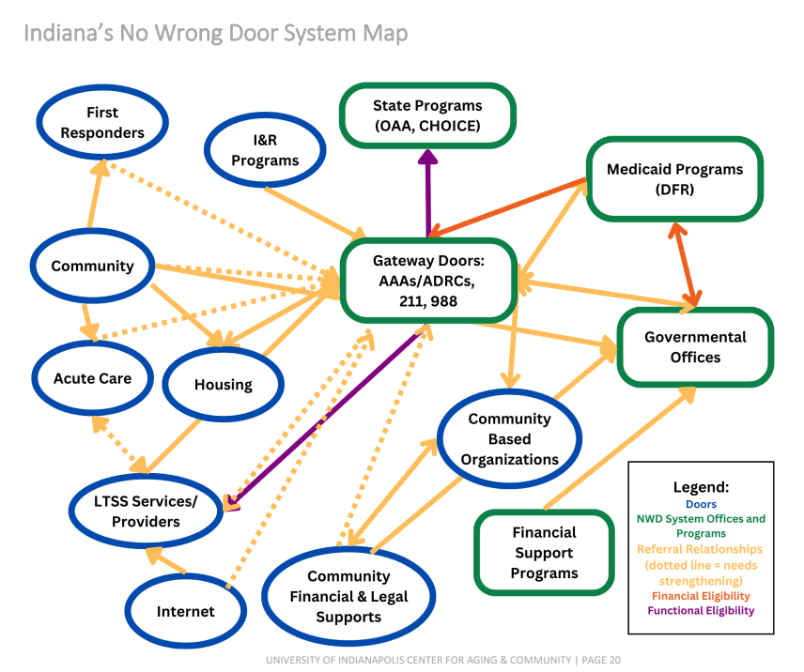
Indiana
NWD System Map
System Gaps
Provider capacity and flow of accurate information across agencies, between doors, and out to consumers.
* Communication and education were identified as priorities.
Identified need for additional governing body members which led to them adding the Indiana Department of Health (IDOH), Indiana Department of Homeland Security (IDHS), and 988 Crisis Response, housed in the Division of Mental Health and Addiction.
† Caregivers report the system is difficult to navigate and information is challenging to find.
† Caregivers are not seeking information or supports until in a crisis, adding to the difficulties of navigating the system.
* Indicates gaps that grantees have listed as a priority to address
† Indicates gaps that affect caregivers
Submitted 10/4/2023
Notes:
From Indiana’s mapping Deliverable:
Referral Relationships
The yellow arrows represent the information and referral relationships and pathways within Indiana NWD System. In a truly No Wrong Door System, information would move between doors as people looking to gain information and access services were moved from door to door. What is important to note in this map is the number and direction of the dotted yellow lines, as these indicate pathways/relationships that do not consistently work well and that are in need of strengthening. In particular, the number of dotted pathways to the gateway doors from other community doors and the dotted lines from gateway doors back out to needed services indicates there is opportunity for improvement in the visibility of the gateway doors of the NWD System and in their ability to smoothly connect people to services once their needs have been assessed.
Eligibility Processes
As indicated by the color coding on pathways, financial eligibility and functional eligibility for programs happen at and between different parts of the system. Multiple stakeholders discussed that these processes do not move concurrently or in similar time frames, making the process of obtaining services challenging. Additionally, both caregivers and providers have mentioned that the closed loop of ensuring involved doors are informed when both eligibility determinations have been completed and services can/did begin needs to be strengthened.

Slide 5
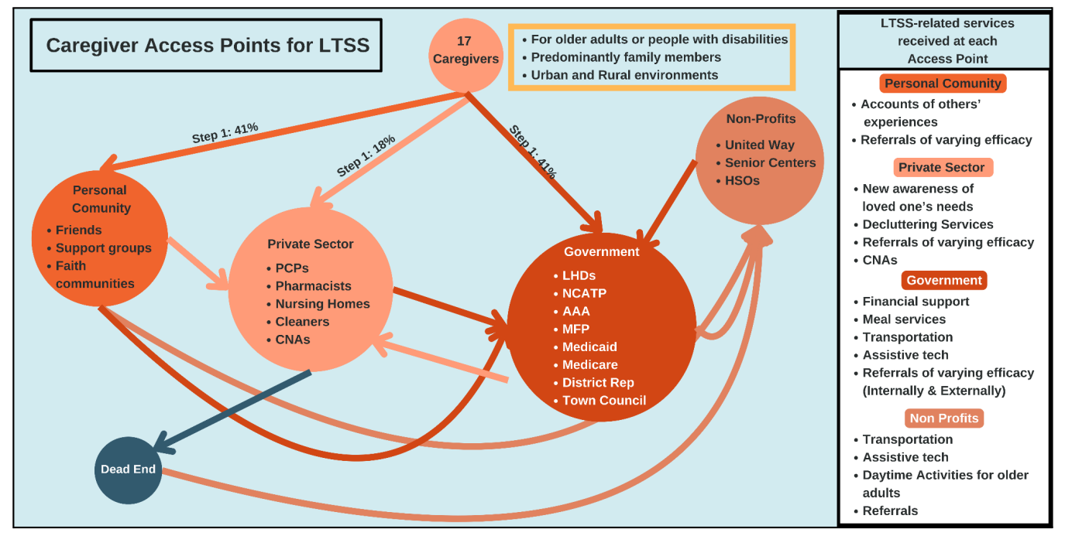
North Carolina
System Gaps
† Lack of centralized data sharing system
† Data collection regarding caregiving is not particularly robust and the connectivity among LTSS agencies appears weak regarding the ability to follow consumers and close the loop on needs.
† Challenges with administration and bureaucracy; Duplication of forms/information requirements
† No central resource for triaging needs
† Access is dependent on luck, friendship, and money.
† Caregivers express financial concerns such as having to spend down assets to qualify for services, the cost of in-home care, and the cost of living for paid caregivers compared to their wages.
† Mismatch with needs and available services, especially home health
† Challenges finding the right services and long times on wait lists
Caregiver Access Pathways Map
Submitted 4/19/2024
† Indicates gaps that affect caregivers
Notes:
From North Carolina Mapping Deliverable:
North Carolina’s Caregiver Access Pathways Map demonstrates the pathways caregivers take when seeking access to services and supports. NC created summary categories for each initial step and you can follow the arrows from each of these initial access points to their subsequent steps on their journey. 41% of caregivers began with a Personal/Community connection as they sought assistance. These included friends with similar (or not) experiences, support groups and faith communities. The Private Sector category, which includes primary care providers, pharmacists, nursing homes, cleaners and Certified Nursing Assistants (CNAs), accounted for 18% of caregivers' entry points. 41% of caregivers had initial contact with the Government in some way. This category includes local health departments (LHDs), NCATP, Area Agencies on Aging, Money Follow the Person, Medicaid, Medicare, Congressional representatives and Town Council members. In the box to the right, are listed the types of services received by caregivers within each category.

Slide 6
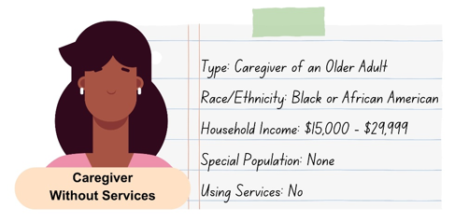
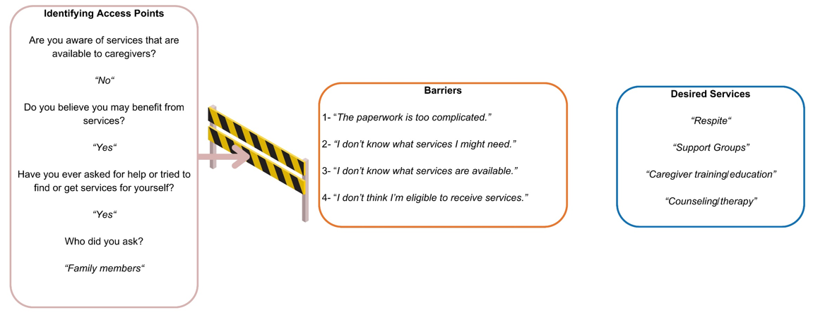
South Carolina
Sample Customer Journey Map
System Gaps
Access points: Provider conflicts/staffing problems, gap between someone becoming eligible and receiving services, quality of case management, waiting lists and lack of connectivity to other agencies, referral to and from state systems for housing, transportation and nutrition is inconsistent
Initial Contact and Intake: Inconsistent messaging and information, staff turnover & sustainability, lack of communication between other agencies and inconsistent warm transfers
Screening & Assessment: Inability to access data/limited integration between programs, assessment not always accessible, duplication, no feedback has been collected from consumers, communication is lacking when clients are discharged from hospitals, waiting lists interfere in accessing services, lack of client understanding regarding referrals, warm transfers are lacking
* PCC: Limited follow-up on past PCC training and most agencies do not have staff officially certified in PCC training
Eligibility determination: Different eligibility standards between departments, eligibility screening take time, MOUs are needed
Service Access and Initiation: Long waitlists across agencies, limited sharing of clients between agencies, and shortage of workers
† Caregiver survey feedback indicated a lack of caregiver supports
† The state system is unable to differentiate caregivers
† Most needed service for family caregivers is respite
Most needed service for older adults is help maintaining the home
Most needed service for adults with disabilities is to feel less isolated
* Indicates gaps that grantees have listed as a priority to address † Indicates gaps that affect caregivers
Submitted 3/5/2024
Notes:
From South Carolina Mapping Deliverable:
South Carolina’s Customer Journey Maps demonstrate the access points, including the barriers and successes of these access points, that a member of the identified target population may experience in accessing LTSS in South Carolina. The depicted journey on the slide is for a caregiver without services, who is unaware of available services but would like to receive services and has unsuccessfully pursued them in the past. Identified barriers for this caregiver are bureaucratic barriers regarding paperwork, not being aware of what services are available or needed, and not considering herself eligible for services. Desired services are identified as respite, support groups, caregiver training/education, and counseling/therapy. In addition to this caregiver map, South Carolina has created caregiver maps for the following target populations as well:
Caregiver with services
Older adult with services
Adult with disabilities with services
Adult with disabilities without services
Older adult without services

Slide 7
Tennessee
System Gaps
† Consumers need to tell their stories multiple times to get the support they need
† Application processes are cumbersome; facilitation of applications is needed at every level
† Caregivers face specific challenges getting information and assistance when moving between states that have different benefits
† Caregivers are limited by their available time. The majority report they do not have time to search for appropriate services due to their caregiving responsibilities, work, and essential daily tasks
† Lack of support in choosing appropriate services
*† Lack of follow-up by agencies who were contacted for assistance
* Lack a closed-loop referral system
* No common training on providing person-centered planning/counseling
* No consistency in providing person-centered planning/counseling
Lack of printed resource materials for persons without internet access
Lack of accessibility for some population groups
Half of all persons seeking LTSS services find information hard to access
Eligibility guidelines and documentation needed to verify eligibility are hard to access
Consumers are rarely told about services that they can pay for themselves
* Indicates gaps that grantees have listed as a priority to address
† Indicates gaps that affect caregivers
Data for graph submitted 12/18/23
Notes:
This graph was created from data included in Tennessee’s narrative and displays the answer to a question posed to 232 respondents who answered their Stakeholder Survey. This survey was targeted to consumers, caregivers, and families, specifically the consumers who called into the toll-free line for TCAD or AAAD assistance. The question posed, “How easy is it to find useful information about services to help with daily needs?” provided four possible answers: Very Hard, Hard, Easy, and Very Easy. The graph displays the difficulty consumers in Tennessee reported feeling in finding information regarding services for daily needs, with half of respondents indicating finding this information was very hard, and just under a quarter reporting it as hard. Only 16% of respondents reported finding this information as “easy,” while just 13% of respondents reported finding such information as “very easy.”

Slide 8
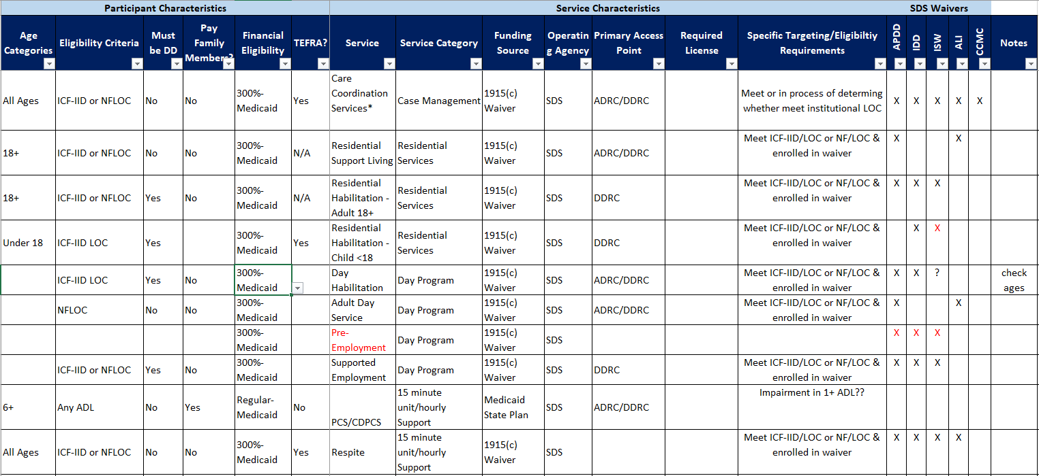
Alaska
Alaska Service Summary
System Gaps
Biggest disconnect in access points is for individuals with mental health and substance use challenges, overseen by Division of Behavioral Health (DBH) – offers limited outreach, DBH initiatives not integrated with ADRC/DDRC network
† Caregivers and individuals in rural areas and those experiencing mental health/substance use challenges, especially co-occurring, face biggest access challenges
† Limited infrastructure or outreach to support family caregivers, limited data collection on family caregivers
† Indicates gaps that affect caregivers
Submitted 9/28/23
Notes:
From Alaska’s Memo:
Service Summary: This worksheet describes each service that is available to people with disabilities and older adults. It contains information about eligibility criteria, funding sources, operating agencies, and access points. It is configurable so that NWD staff can easily identify all services available to a particular individual. Staff at the Aging and Disability Resource Centers (ADRCs) and Developmental Disability Resource Connections (DDRCs) will receive training on how to use this worksheet in early 2024.

Slide 9
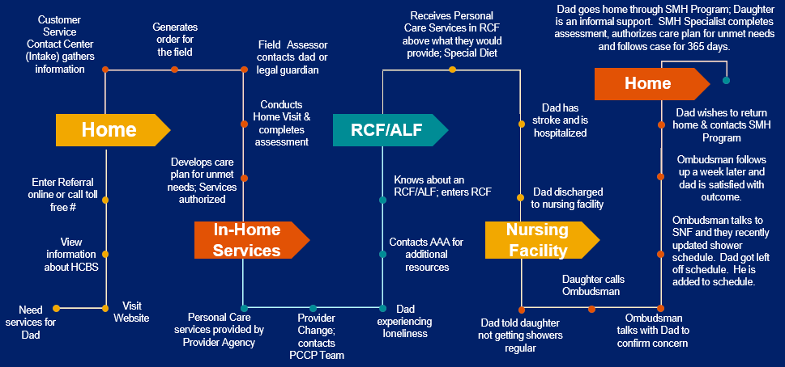
Missouri
A Customer Journey through LTSS
System Gaps
*† State agencies are siloed and have distinct processes for accessing services, including IR&A
† Limited cross-systems knowledge on service availability and eligibility criteria between LTSS for seniors, people with I/DD, and people with physical disabilities
† Variability in definition for “options counseling,” including what each system calls this service and who provides it
† Disjointed access points online (i.e., key search terms indicate where individuals are directed) and by phone (i.e., the Missouri Senior Resource Line provides resources primarily for seniors)
* Indicates gaps that grantees have listed as a priority to address
† Indicates gaps that affect caregivers
Submitted 12/15/23
Notes:
From Missouri’s Mapping Deliverable
This Customer Journey through LTSS map was created by Missouri’s Department of Health and Senior Services in September 2023. Its purpose is to demonstrate how an individual may move through the LTSS system in Missouri, providing examples of how an individual may access services, receive needed services, and be transitioned from a care setting to a home. It has been included in Missouri’s mapping deliverable as one of several examples for a journey through DHSS programs and the LTSS system.
In this specific example, Dad requires services and becomes aware of HCBS, and works with a Customer Service Contact Center and Field Assessor to receive in-home services. Due to loneliness, Dad enters RCF, but has a stroke and is hospitalized and discharged to a nursing facility. Due to an issue with the shower schedule, Dad’s daughter calls the Ombudsman and he is returned home through the SMH Program with his daughter as an informal support, with an SMH Specialist following the case for a full 365 days post-transition.

Slide 10
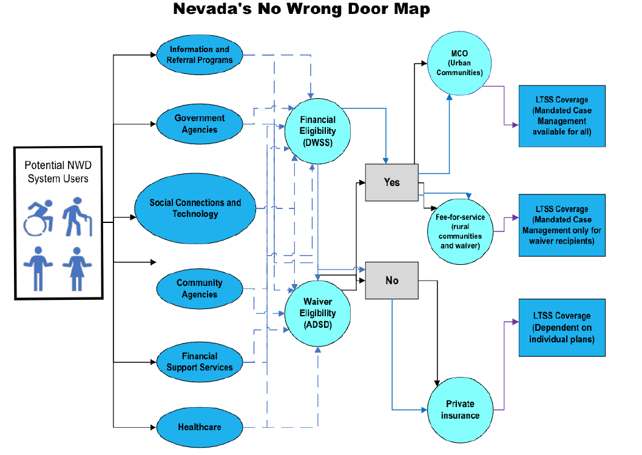
Nevada
Nevada’s No Wrong Door Map
System Gaps
Access to LTSS is limited to MCO Medicaid eligible Nevadans in Washoe or Clark Counties or those eligible for waiver services; remaining Nevadans use FFS Medicaid without LTSS
No universal definition of LTSS statewide
System often includes undertrained staff and high staff turnover
* Consumers cited barriers to access, including: Long wait lists and duplicative paperwork Lack of accessible information or service options as major barrier (i.e., overall lack of providers) Fear of or lack of trust in the system, often due to bureaucratic burden
Access to services often impacted by assigned case manager’s personal relationship to other providers
† Overreliance on family and consumer advocate networks/word of mouth to learn about and access services
* Indicates gaps that grantees have listed as a priority to address
† Indicates gaps that affect caregivers
Submitted 1/12/24
Notes:
From Nevada’s Mapping Deliverable:
Nevada’s No Wrong Door Map, indicating a potential NWD System User will need to take one of six paths to get into the NWD System – I&R programs, government agencies, social connections and technology, community agencies, financial support services, and health care. From these six paths, Nevada has two paths to LTSS: The Division of Welfare and Supportive Services (DWSS) that determines financial eligibility, and the Aging and Disabilities Services Division (ADSD) that determines waiver eligibility. If not eligible for either, an individual must gain LTSS coverage through private insurance; if eligible, individuals in urban communities receive LTSS coverage through MCO, and individuals in rural communities or who are waiver eligible received fee-for-service LTSS coverage.

Slide 11
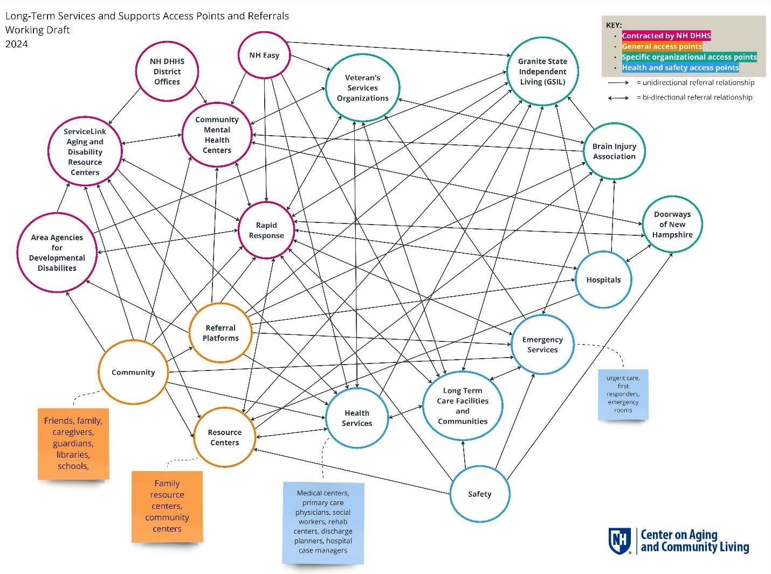
New Hampshire
Long-Term Services and Supports Access Points and Referrals
System Gaps
Uncertainty among individuals regarding how to access LTSS, exacerbated by language and translation errors and discrimination
† Caregivers and individuals struggle to identify as someone who needs or should access assistance
Outreach and marketing may not impact all populations equitably
Intake processes are often lengthy and overwhelming for consumers; contributing factors include information sharing and perception of eligibility Application and eligibility processes are complicated and sometimes duplicative
Intake/assessment tools are inconsistent and there is limited ability for cross-system sharing
Access point partners do not always refer individuals where needed due to working in siloes
Shrinking workforce, frequent turnover, and low wages lead to issues in service delivery
† Staff face challenges tailoring supports to unique needs of populations, especially caregivers
† Indicates gaps that affect caregivers
Submitted 7/30/24
Notes:
From New Hampshire DHHS Meeting Slide Deck:
Map showing the LTSS access points in New Hampshire, as identified by the mapping process under the Governance Grant and current as of September 2023. The green boxes indicate access points contracted by the New Hampshire Department of Health & Human Services, while the blue boxes indicate other access points, including referral platforms, stakeholder facilitated access points, and informal access points. Referrals are indicated with arrows, all of which (except for informal referrals from friends, family, guardians, caregivers, or local newspapers) feed into NH Care Path, which is comprised of ServiceLink, DHHS District Offices, Area Agencies for Developmental Disabilities, and Community Mental Health Centers. Informal access points that do not feed directly into NH Care Path instead refer to NH Care Path access points (i.e., Care Path website, NH Easy website, 211).

Slide 12
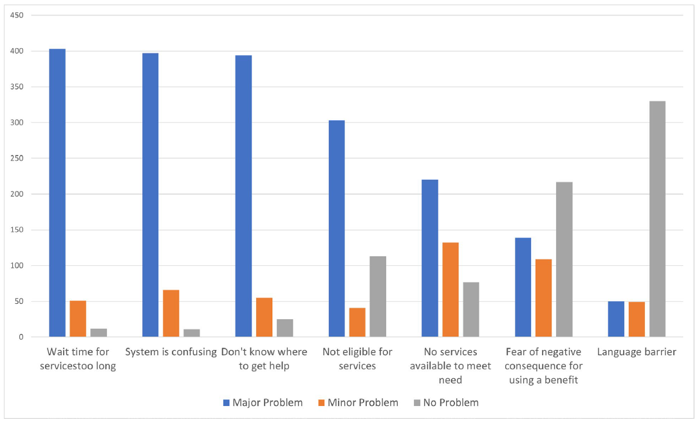
Texas
Caregiver Respondents’ Ranking of Problems Experienced within NWD System
System Gaps
No single set of processes or definitions to guide primary access points in conducting primary functions of the NWD System
Difficulty optimizing client experience and support (e.g., methods and/or support to access NWD resources and managing/supporting client experience) Lack of visibility in application process and status Length of interest lists/time delays Language barriers
Challenges with technology
† Caregiver strain (e.g., methods and supports to access NWD resources, managing and supporting client experience)
† Indicates gaps that affect caregivers
Submitted 1/29/24
Notes:
From Texas’ Mapping Deliverable:
Caregivers were asked to rank the problems they experienced in the NWD System as a major problem, a minor problem, or as not a problem. The problems identified as major most often were wait time for services being too long, the system being confusing, and that they are unsure of where to go for help. These were followed by not being eligible for services and there not being services available to meet needs. The last two problems were mostly identified as not being problems and were a fear of negative consequence for using a benefit and language barriers. Caregivers also rated a set of states regarding navigating the NWD System as below average, the top three being 1) it is not easy to find the help needed, 2) concerns about services are not handled in a timely manner, and 3) information provided is not consistent.

Slide 13
Common Themes and Findings
PCC and PCC training
  Grantees indicated varied definitions of PCC and LTSS resulted in inconsistent application of PCC and delivery of services
Updates/changes to IT systems can be leveraged as a source for sustainability and collaboration
Gaps in referral systems and need for streamlined access
Inconsistent screening and assessment processes and inadequate assessment tools
Inadequate workforce (providers, access point staff trained in PCC) and high staff turnover in access point staff
Notes:
PCC, Training, and Definitions
Variability in definitions for “person-centered counseling,” “options counseling,” “long-term services and supports” among states, as well as which organizations provide these service
Staff/personnel do not receive consistent training and are often unaware of existing resources; common training does not exist and PCC is provided inconsistently
Some individuals accessing systems do not receive person-centered planning services at all
No coordinated, consistent set of processes or definitions to guide primary access points in providing PCC, leading to disconnected and overwhelming experience for individuals accessing services
Updates to IT Systems for Sustainability
States have identified revamped IT infrastructure to streamline eligibility and ensure sustainability
Nevada working with Division of Welfare and Supportive Services to collapse multiple eligibility applications into single online application
Texas indicated no single IT system is used by all entities and no consistent policies for tracking, documenting, and following referrals impact their streamlined eligibility
Gaps in Referrals and Streamlined Access
States reported that consumers must tell their stories multiple times and speak to multiple people to get needed information and services
General siloed approach to IR&A and referrals and often limited cross-systems knowledge of services and supports on the part of staff
Providers and organizations experience challenges receiving information about challenges from other agencies due to silos preventing information sharing – instances where a single person had multiple cases open across agencies to provide them services
Application processes are cumbersome and duplicative, and some consumers give up on receiving services rather than continuing through application process; individuals who need assistance completing paperwork are also often not assisted
Inconsistent Screening and Assessment
Access to services varied considerably by several metrics, including disability type, region, organization type contacted for services, the strength and experience of one’s case manager, and even search terms used online to find services
Different agencies have their own distinct processes for assisting individuals in accessing services and supports, and there’s often a lack of interoperability between these agencies
Where processes are in place for referrals, they have no uniformity or consistency across different agencies and access points
Processes to determine eligibility for different services and programs happen at different speeds (e.g., Medicaid, waiver programs)
Inadequate Workforce to Meet Needs
Challenges with access to services due to difficulty in matching staff capacity to demand for services, including for HCBS services
System may be staffed by undertrained personnel and plagued by high turnover rates, further exacerbating lack of experience and training
High volume of calls and referrals to AAAs mean that AAA staff are often overwhelmed
In some states, a lack of providers mean users have limited choice in service options once they are able to access LTSS

Slide 14
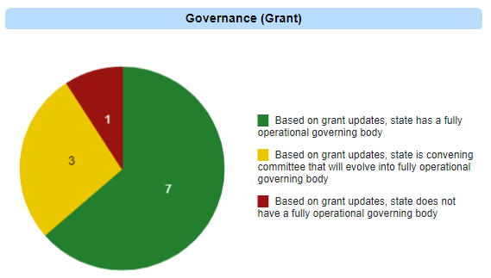
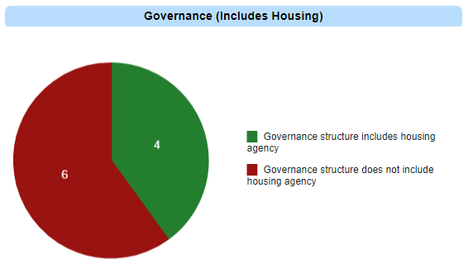
Governing Body Progress
Notes:
Governance (Grant)
Pie chart is based on grant updates received from grantees via 1:1 call or email
Seven grantees have a fully operational governing body based on updates TA Team has received from said grantees (CA, IN, NH, SC, TN, TX)
Three grantees (MO, NV, NC) are convening committees that they plan to have evolve into a fully operational governing body
One grantee (AK) does not yet have a fully operational governing body, although they are actively communicating with and plan to convene a governing body
Governance (Includes Housing)
Like Governance (Grant) chart, pie chart is based on grant updates received from grantees via 1:1 call or email
Four of the grantees have a governance structure that includes a housing agency (CA, IN, NH, TN)
Six of the grantees have a governance structure that does not include a housing agency (AK, MO, NV, NC, SC, TX)

