Slide 1
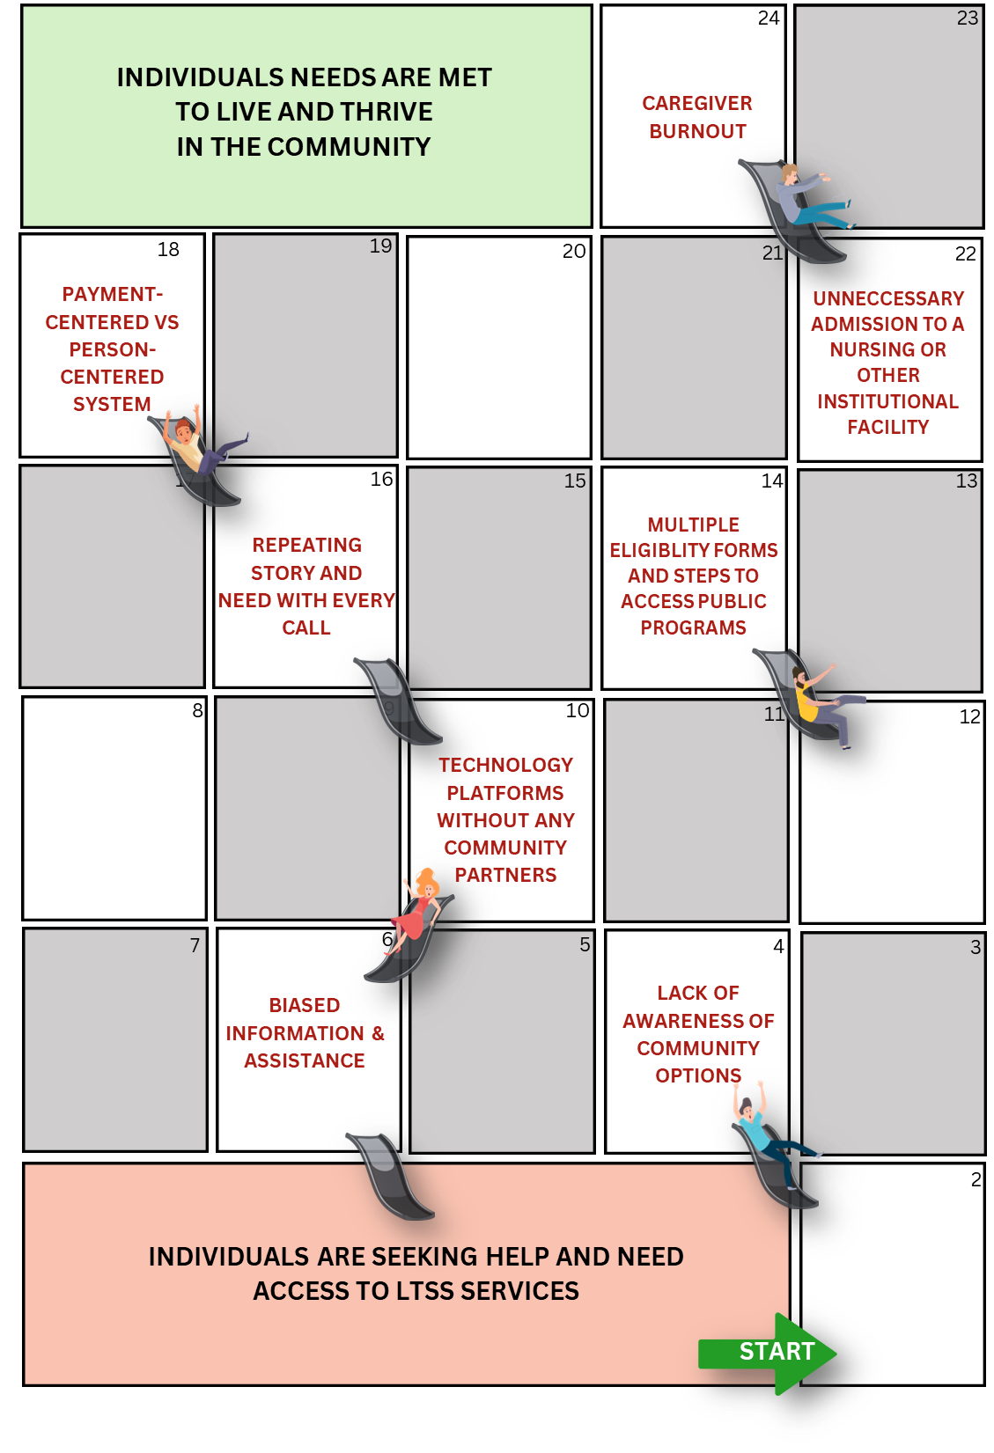

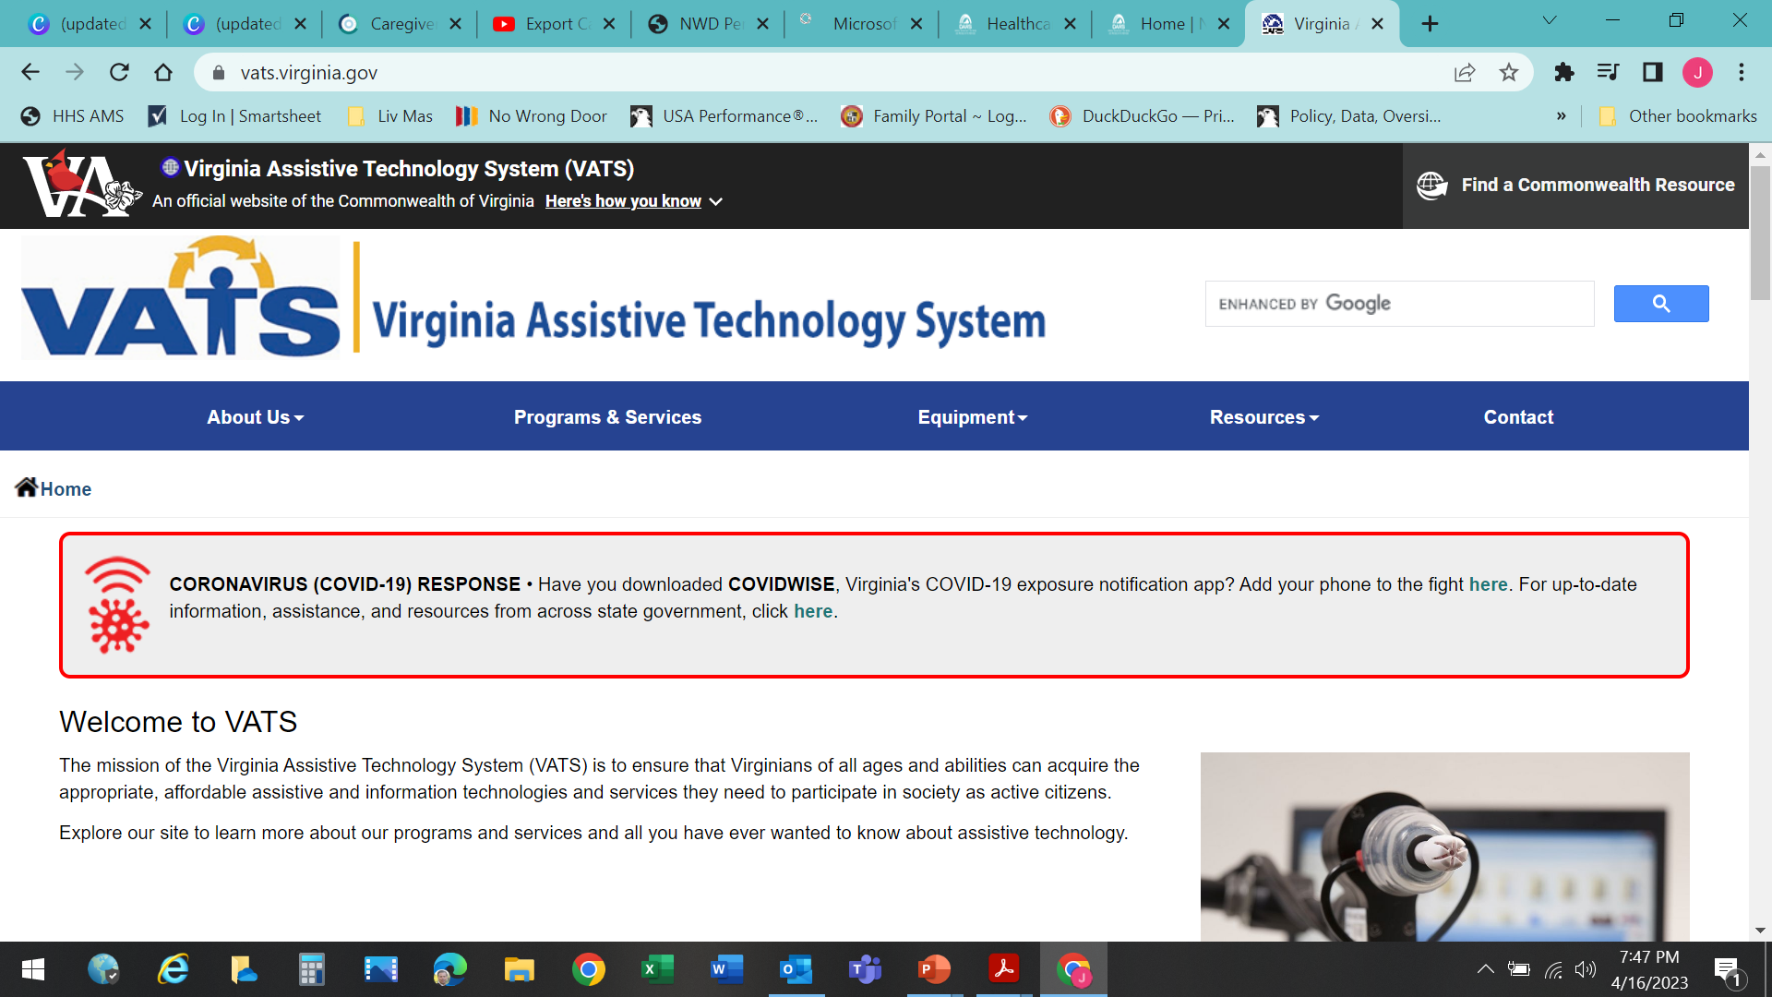

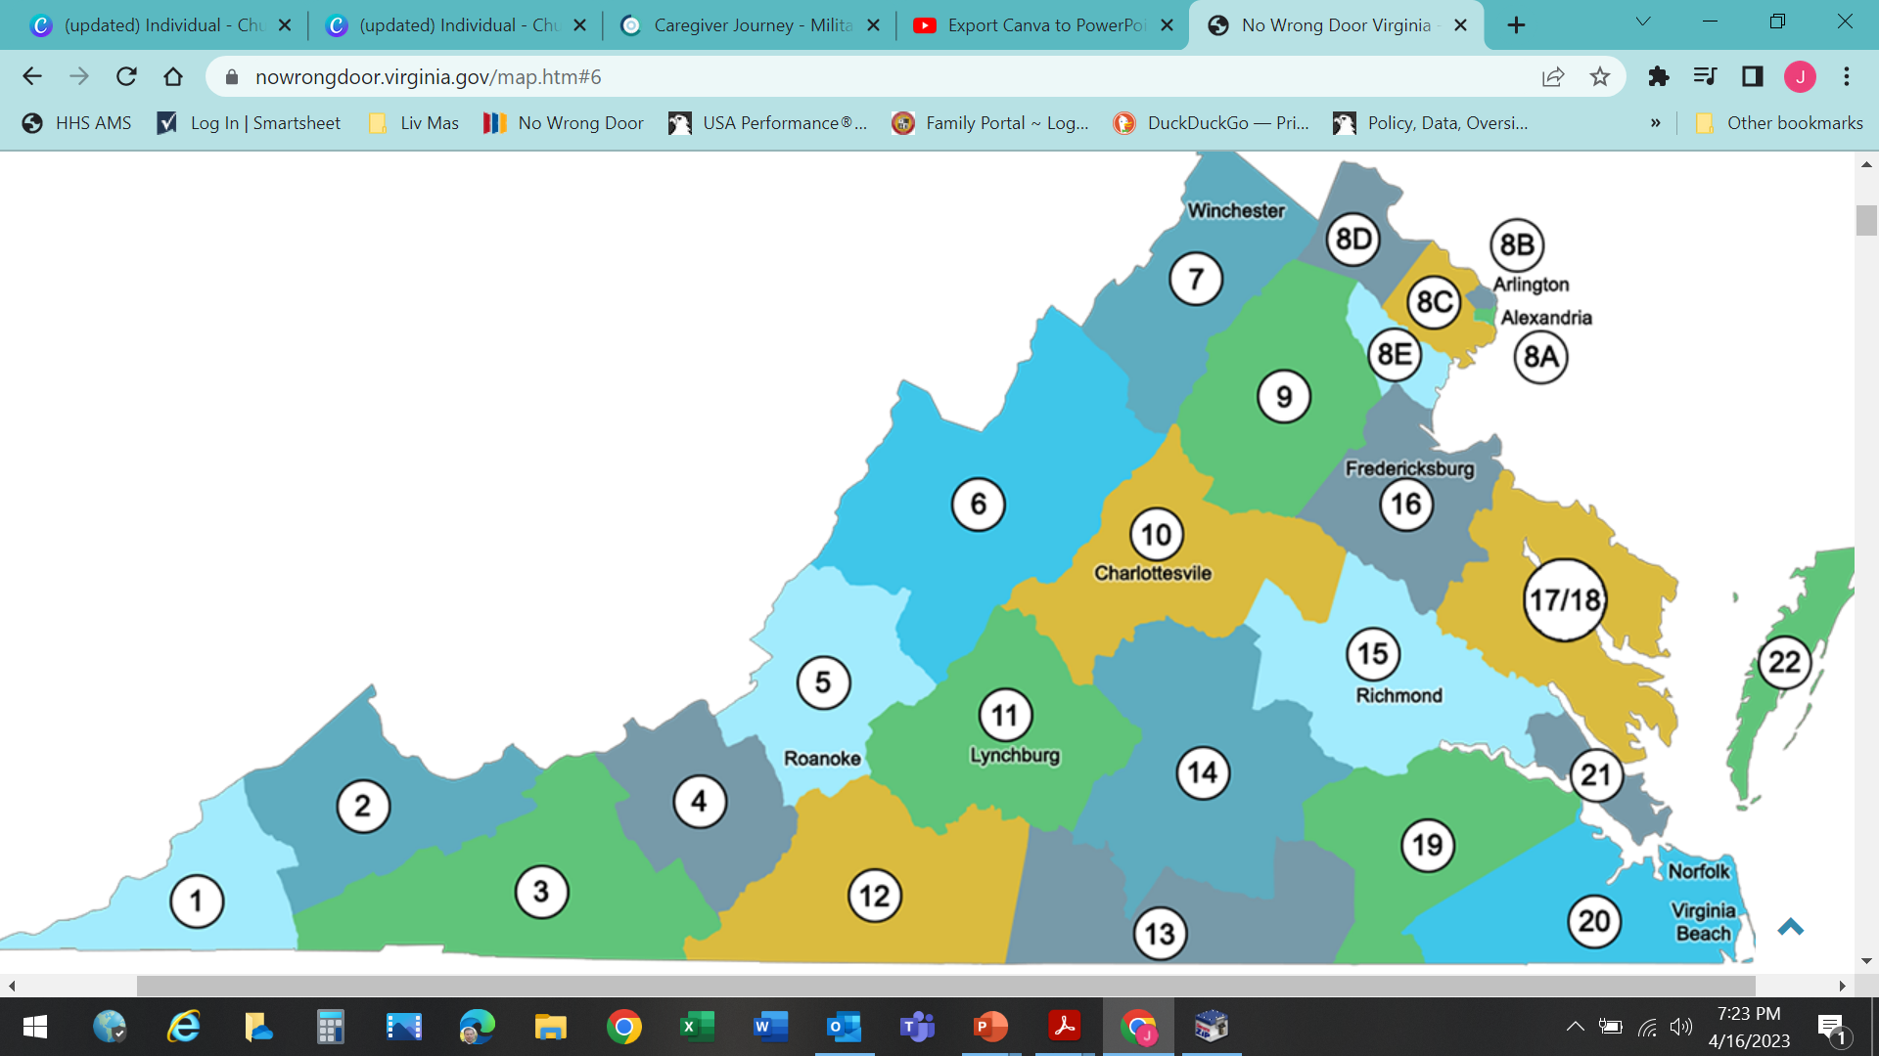
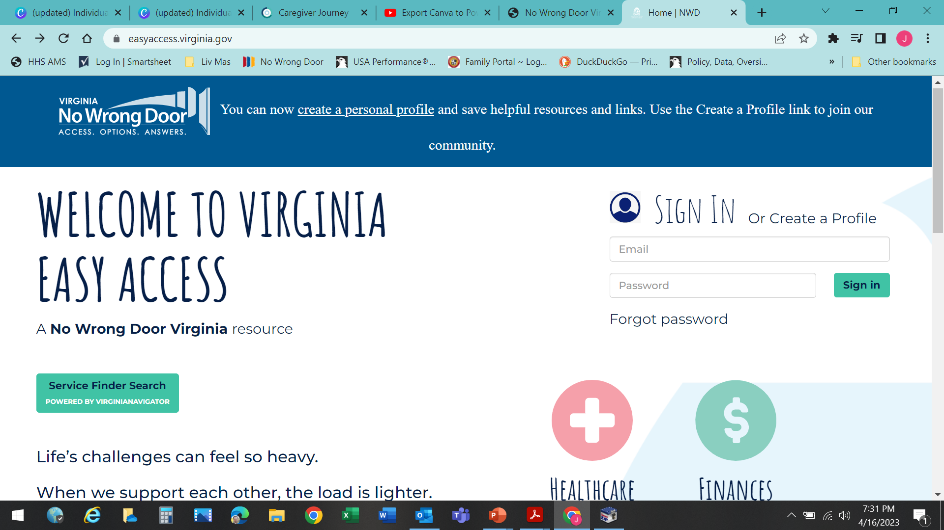





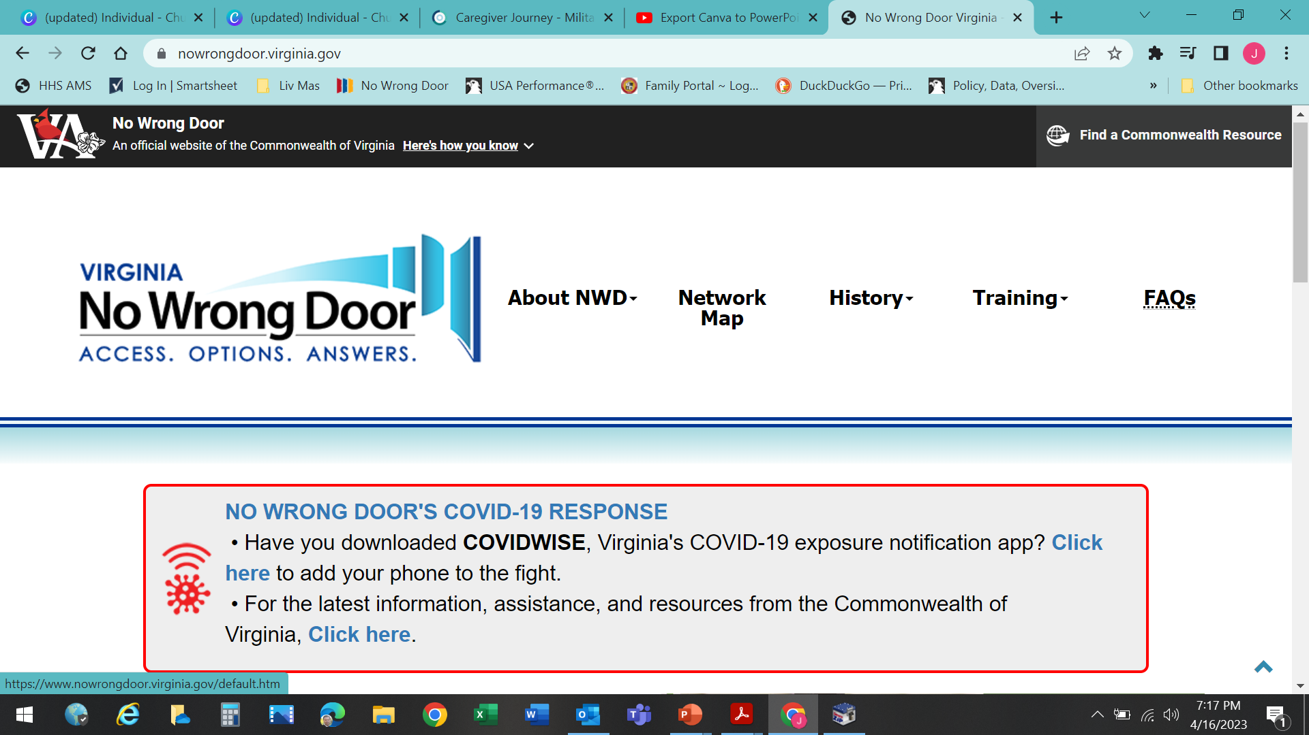
TRUSTED SOURCE OF INFORMATION
VIRGINIA OPTIONS CONSELING STATEWIDE STANDARDS
MULTIPLE, COORDINATED ACCESS POINTS THROUGH STATE REFERRRAL SYSTEM, CRIA
FORMAL PARTNERSHIPS
FOR INCREASED ACCESS AND WARM TRANSFERS

